Slide 1
Outdoor Play Canada: Cartoons

Slide 2
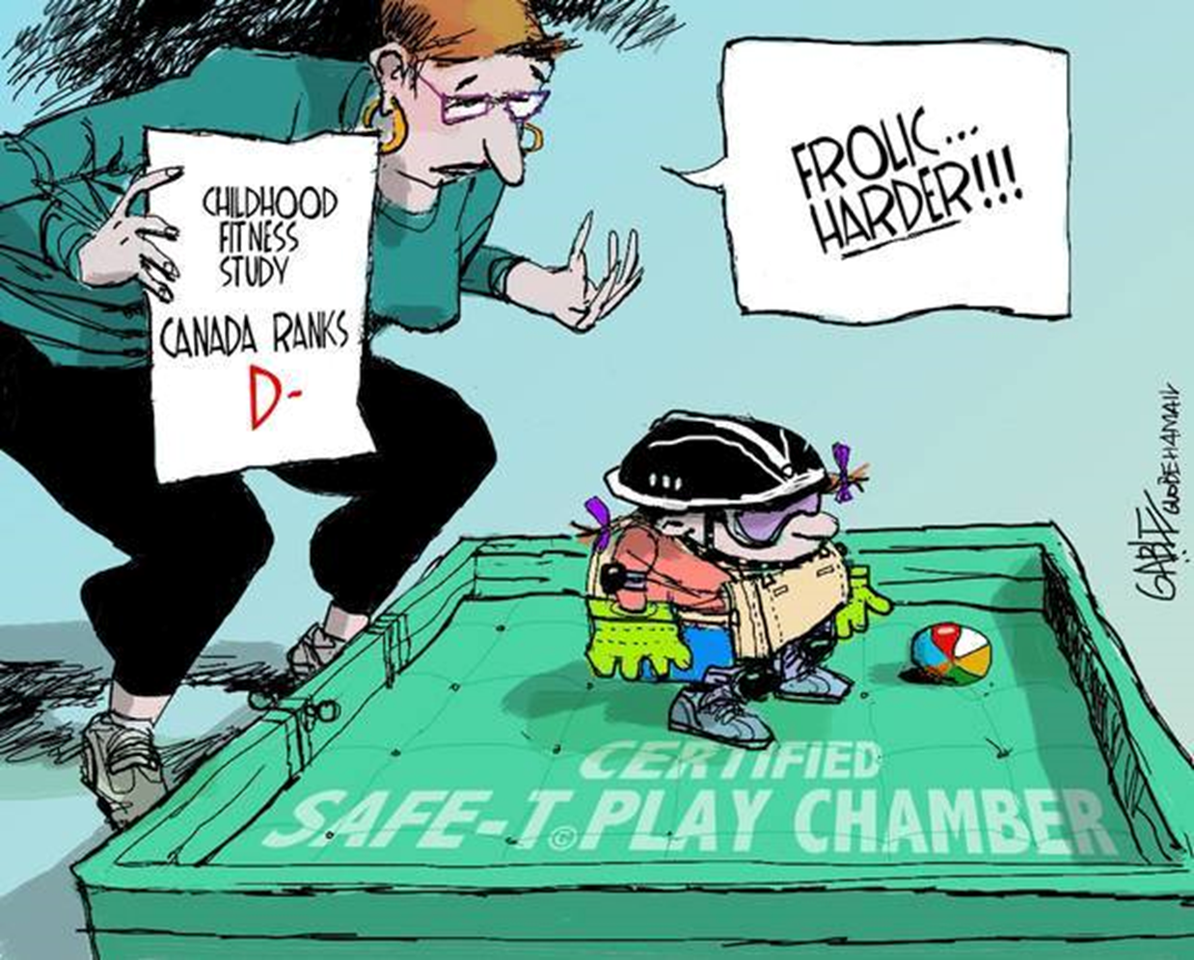

Slide 3
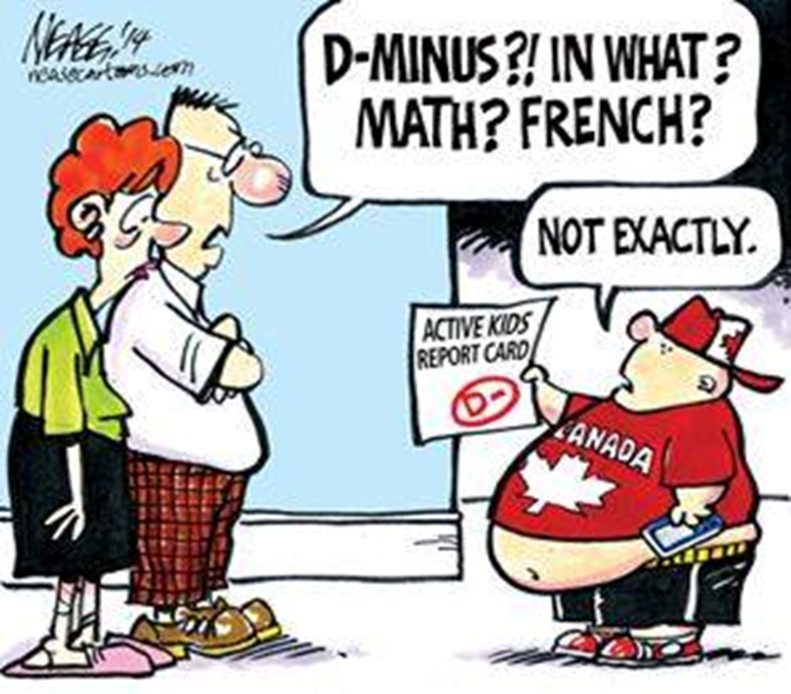

Slide 4
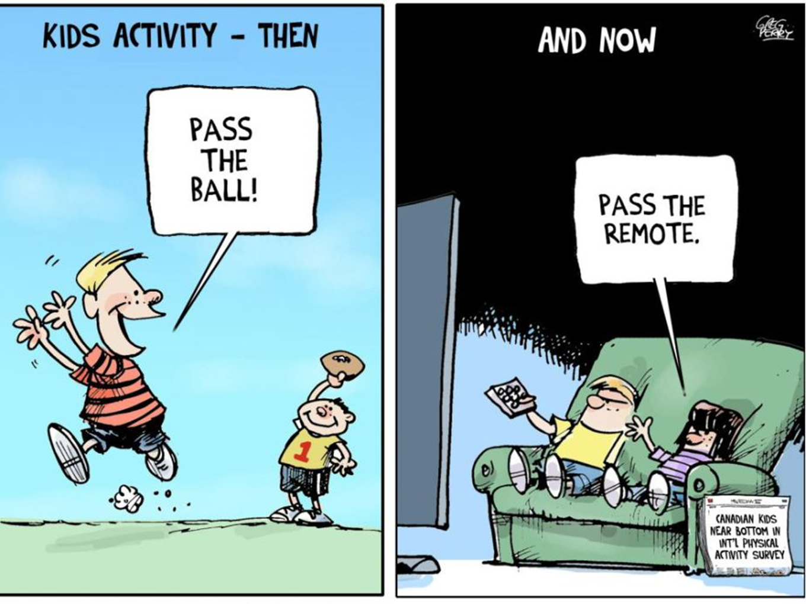

Slide 5
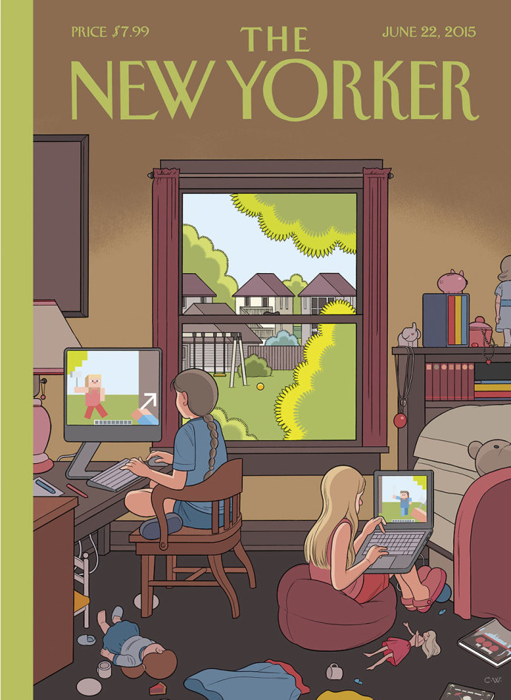

Slide 6
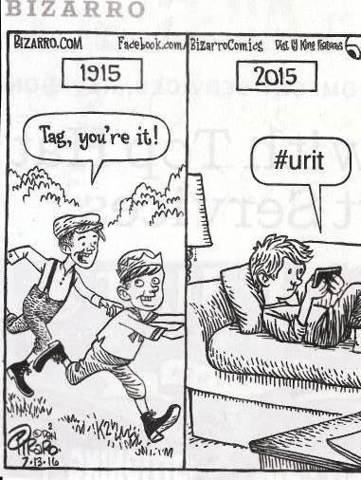

Slide 7
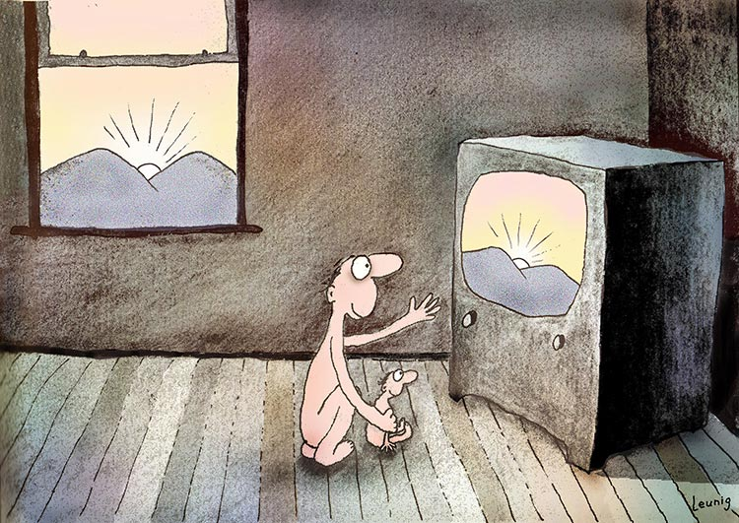
http://www.leunig.com.au/

Slide 8
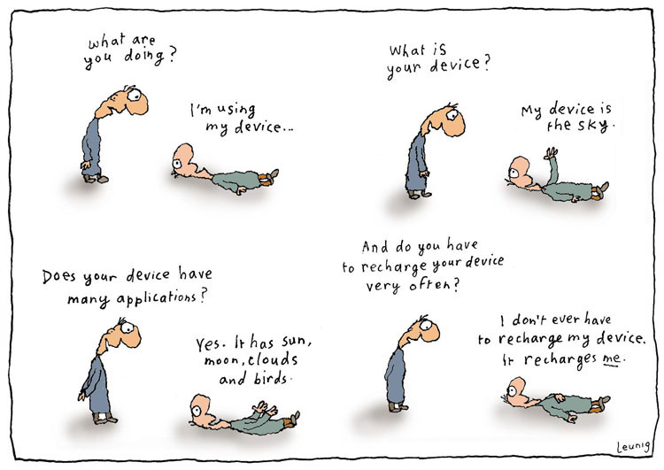
http://www.leunig.com.au/

Slide 9
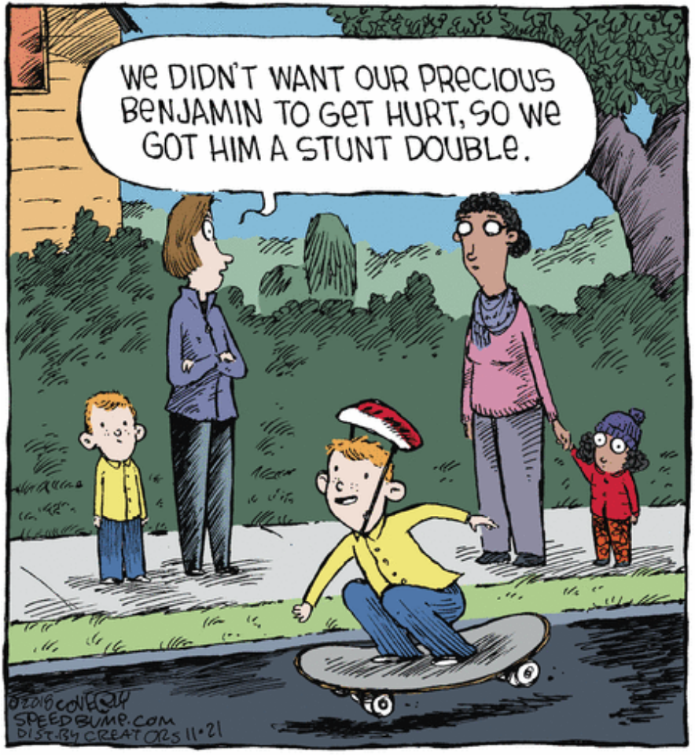
Anxiety-based caregiving
Notes:
Fear is a big limiting factor
https://www.gocomics.com/speedbump/2018/11/21

Slide 10
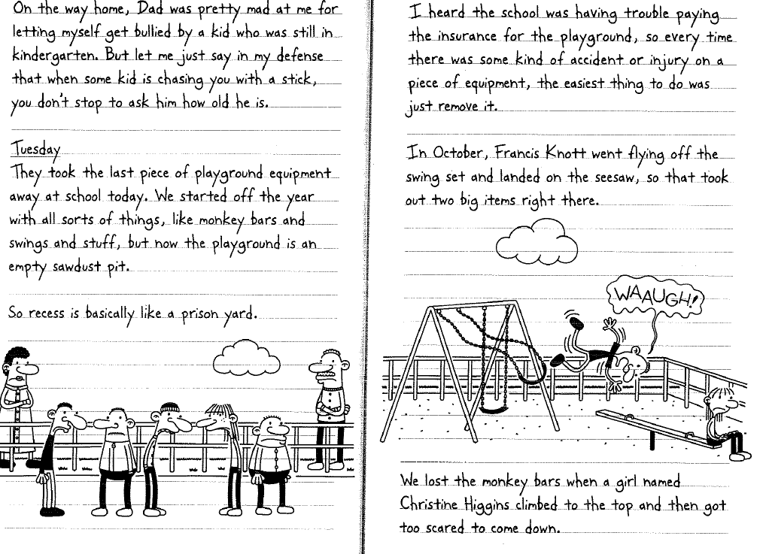

by Jeff Kinney

Slide 11
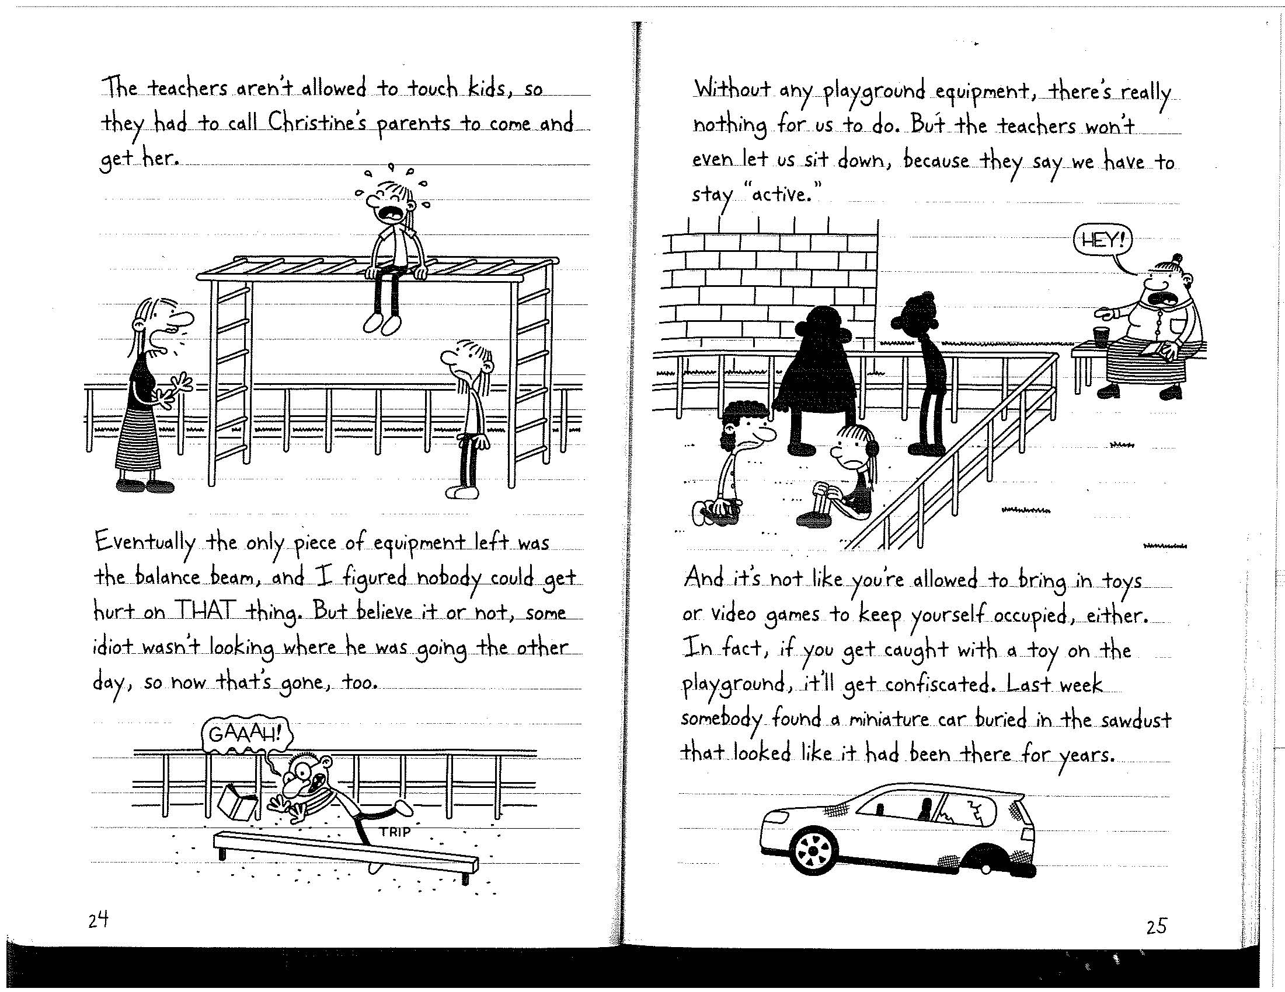

Slide 12
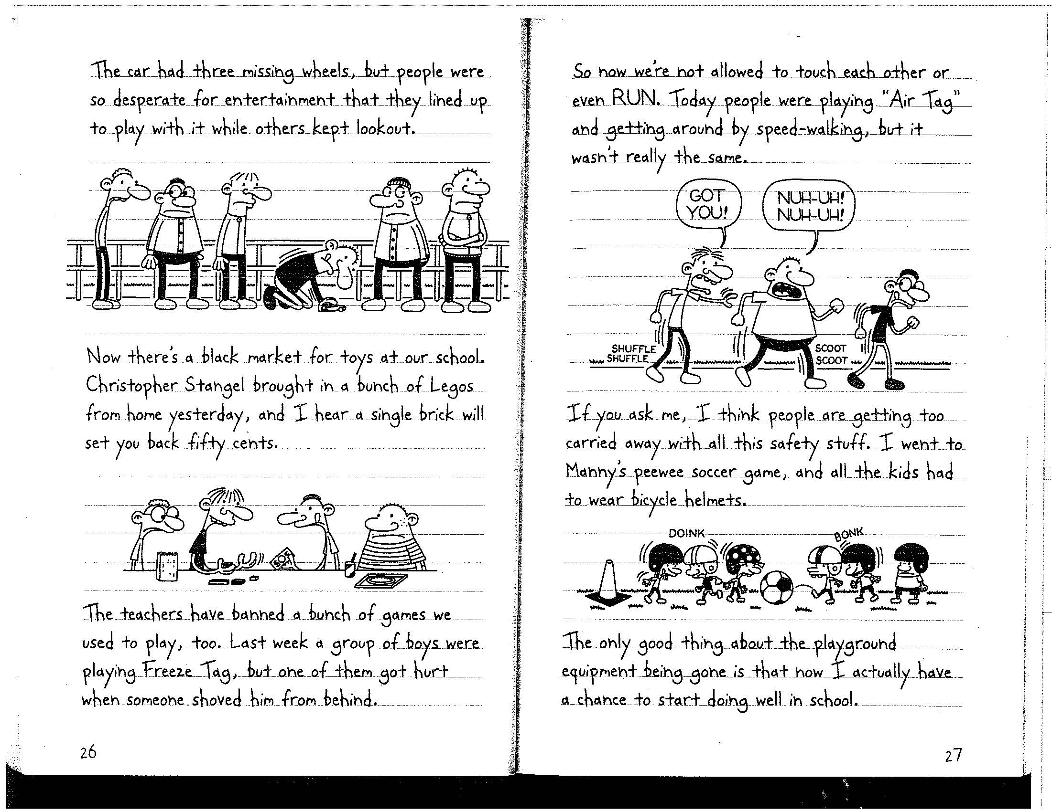

Slide 13
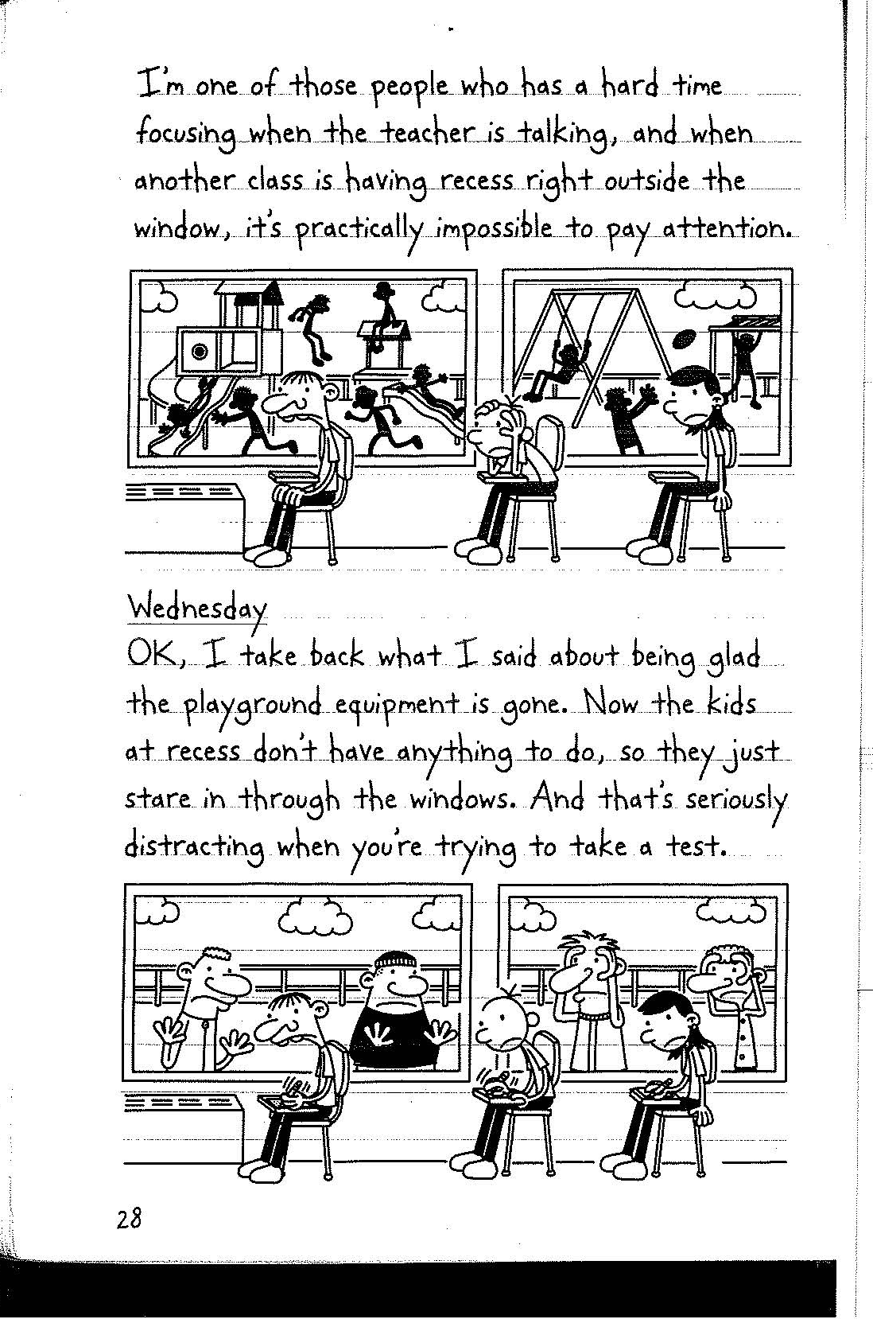

Slide 14
Doonesbury by Gary Trudeau
May 29, 2016
Notes:
http://doonesbury.washingtonpost.com/strip/archive/2016/05/29

