Slide 1
The Position Statement on Active Outdoor Play

Slide 2
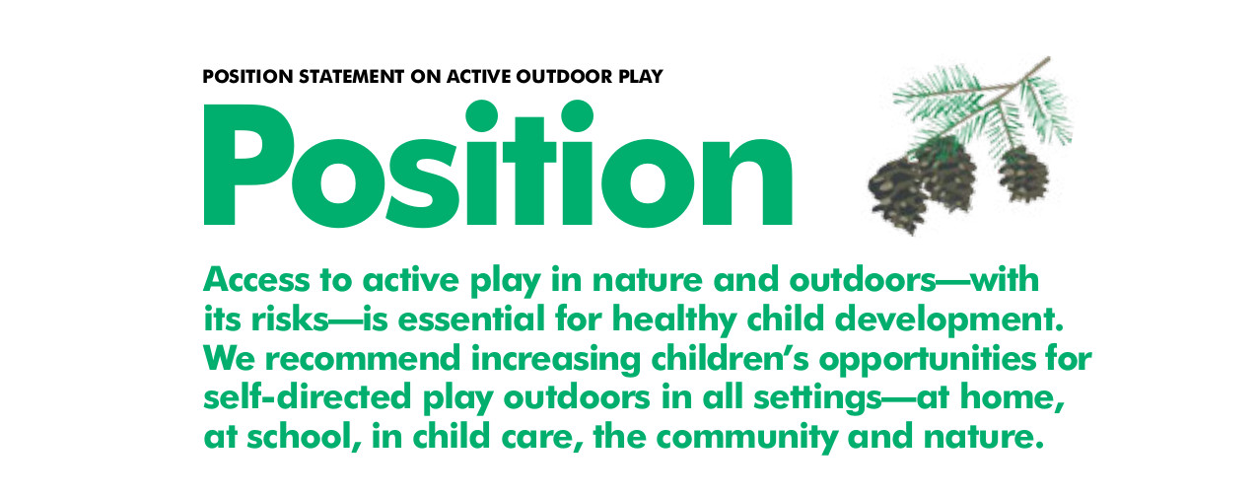
www.participaction.com/report-card-2015/report-card/

Slide 3
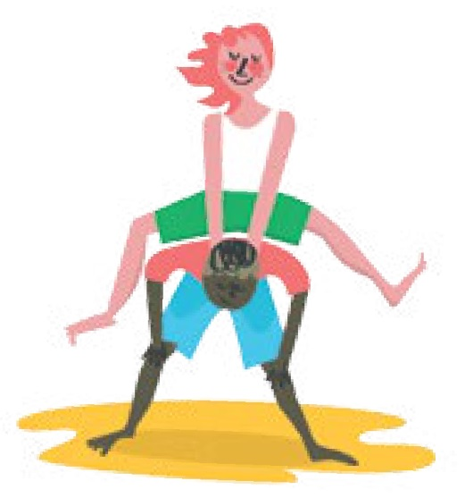
Position Statement
This Position Statement was informed by the best available evidence, interpreted by a group of Canadian experts representing 14 organizations, and reviewed and edited by more than 1,600 stakeholders. Details of the process are published in the International Journal of Environmental Research and Public Health (www.mdpi.com/journal/ijerph).

Slide 4
Context
2 systematic reviews conducted to examine best available scientific evidence on the net effect (i.e., balance of benefits vs. harms) of outdoor and risky active play.
Other research and reviews consulted.
Position Statement applies to girls and boys (aged 3-12 years) regardless of ethnicity, race, or family socioeconomic status.
Children who have a disability or a medical condition should also enjoy active outdoor play in compliance with guidance from a health professional.

Slide 5
Context
Have we, as a society, lost the appropriate balance between keeping children healthy and active and protecting them from serious harm?
If we make too many rules about what they can and can’t do, will we hinder their natural ability to develop and learn?
If we make injury prevention the ultimate goal of outdoor play spaces, will they be any fun?
Are children safer sitting on the couch instead of playing actively outside?

Slide 6
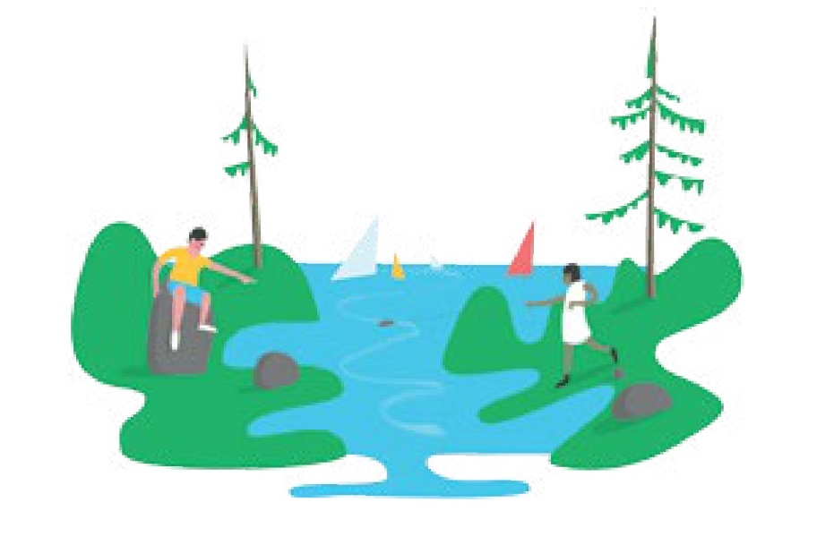
Context
We need to recognize the difference between danger and risk. And we need to value long-term health and fun as much as we value safety.

Slide 7
What risk means
In play, risk doesn’t mean courting danger—like skating on a half-frozen lake or sending a preschooler to the park alone.
It means the types of play children see as thrilling and exciting, where the possibility of physical injury may exist, but they can recognize and evaluate challenges according to their own ability.
It means giving children the freedom to decide how high to climb, to explore the woods, get dirty, play hide ’n seek, wander in their neighborhoods, balance, tumble and rough-house, especially outdoors, so they can be active, build confidence, autonomy and resilience, develop skills, solve problems and learn their own limits.
It’s letting kids be kids—healthier, more active kids.

Slide 8
Evidence
When children are outside, they move more, sit less and play longer —behaviors associated with improved cholesterol levels, blood pressure, body composition, bone density, cardiorespiratory and musculoskeletal fitness and aspects of mental, social and environmental health.
Hyper-parenting limits physical activity and can harm mental health.
When children are closely supervised outside, they are less active.

Slide 9
Outdoor Play is Safer than You Think!
The odds of total stranger abduction are about 1 in 14 million based on RCMP reports. Being with friends outdoors may further reduce this number.
Broken bones and head injuries unfortunately do happen, but major trauma is uncommon. Most injuries associated with outdoor play are minor.
Canadian children are eight times more likely to die as a passenger in a motor vehicle than from being hit by a vehicle when outside on foot or on a bike.

Slide 10
Stranger Danger
Risk of abduction by a stranger in Canada: ≈1:14,000,000
Leave child unattended for 200,000 years
Warwick Cairns
Dalley & Ruscoe (2003)

Slide 11
Is the Indoors Really Safer?
When children spend more time in front of screens, they are more likely to be exposed to cyber-predators and violence as well as eat unhealthy snacks.
Air quality indoors is often worse than outdoors, increasing exposure to common allergens (e.g., dust, mold, pet dander), infectious diseases, and potentially leading to chronic conditions.
In the long-term, sedentary behavior and inactivity elevate odds of developing chronic diseases, including heart disease, type 2 diabetes, some forms of cancer and mental health problems.

Slide 12
Evidence
Children are more curious about, and interested in, natural spaces than prefabricated play structures. Children who engage in active outdoor play in natural environments demonstrate resilience, self-regulation and develop skills for dealing with stress later in life.
Outdoor play that occurs in minimally structured, free and accessible environments facilitates socialization with peers, the community and the environment, reduces feelings of isolation, builds inter-personal skills and facilitates healthy development.

Slide 13
Recommendations
Parents: Encourage your children to engage more fully with their outdoor environments in a variety of weather conditions. When children are supported to take risks, they have more fun and learn how to assess and manage risk in all areas of their lives.
Educators and Caregivers: Regularly embrace the outdoors for learning, socialization and physical activity opportunities, in various weather conditions—including rain and snow. Risky active play is an important part of childhood and should not be eliminated from the school yard or childcare center.
Health Professionals: Be influential! Promote every child’s connection with nature and the outdoors—identify outdoor play resources and partner with municipalities, parks, nature-related organizations, parent groups and children to support this process.

Slide 14
Recommendations
Injury Prevention Professionals: Find a balanced approach to health promotion and protection that considers the long-term dangers of a sedentary lifestyle along with the acute potential for injury.
School and Child Care Administrators: Choose natural elements over pre-fabricated playgrounds and paved areas—and encourage children to play in, and help design, these environments.
Media: Provide balanced reporting—sensationalizing stories about predators and danger elevates fear; cover success stories related to outdoor and risky active play.

Slide 15
Recommendations
Attorneys General: Establish reasonable liability limits for municipal governments—this means Joint and Several Liability Reform.
Provincial and Municipal Governments: Work together to create an environment where Public Entities are protected from frivolous lawsuits over minor injuries related to normal and healthy outdoor risky active play. This protection would no longer restrict Public Entities to using the Canadian Standards Association CAN/CSA Z614 “Children’s Playspaces and Equipment” as a guide for the design of outdoor play spaces and as a requirement for the funding of these spaces. An increased investment in natural play spaces in all neighborhoods is encouraged.

Slide 16
Recommendations
Schools and Municipalities: Examine existing policies and by-laws and reconsider those that pose a barrier to active outdoor play.
Federal and Provincial/Territorial Governments: Collaborate across sectors to find ways to improve children’s access to risky active play in nature and the outdoors.
Society: Recognize that children are competent and capable. Respect parents’ assessments of their children’s abilities and their decisions to encourage self-directed play in nature and the outdoors. Allow all children to play with and form a lasting relationship with nature on their own terms.

Slide 17
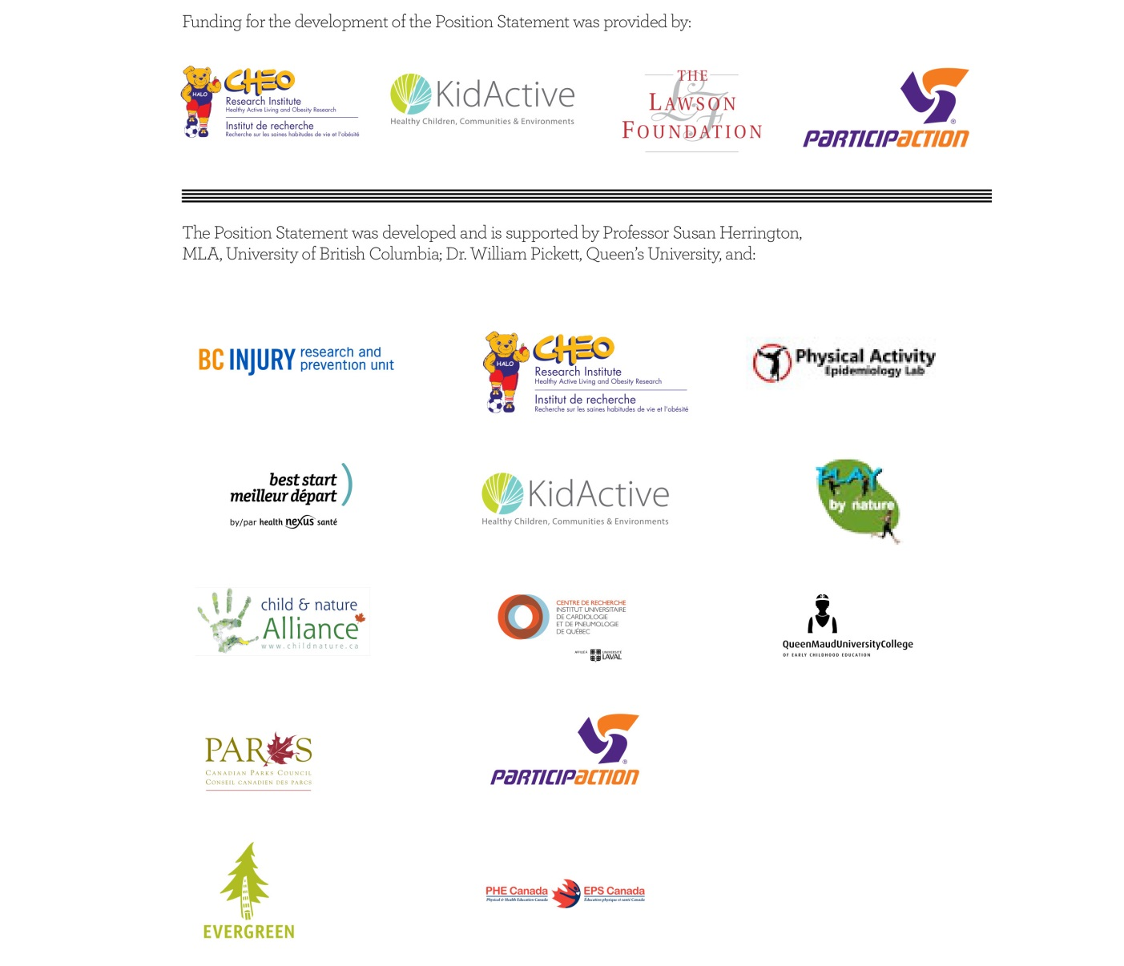
Acknowledgments

Slide 18
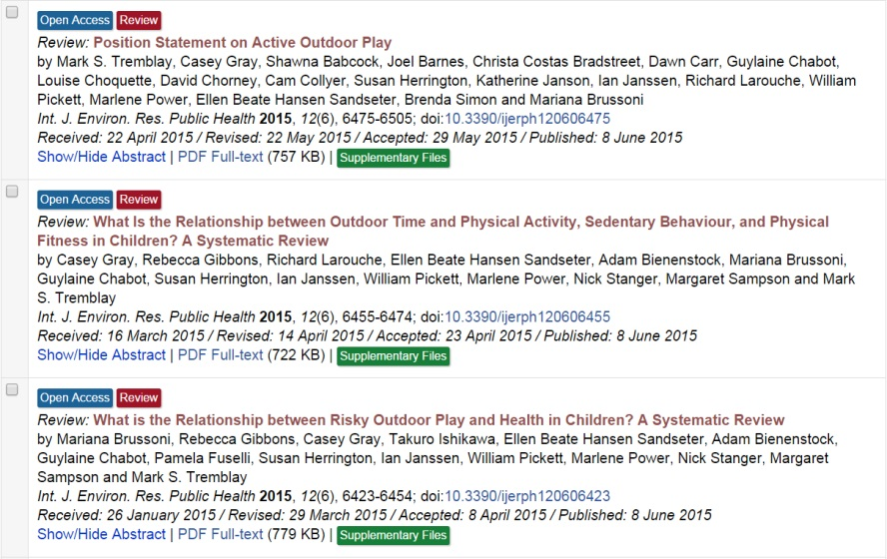
Background papers
www.mdpi.com/journal/ijerph

Slide 19
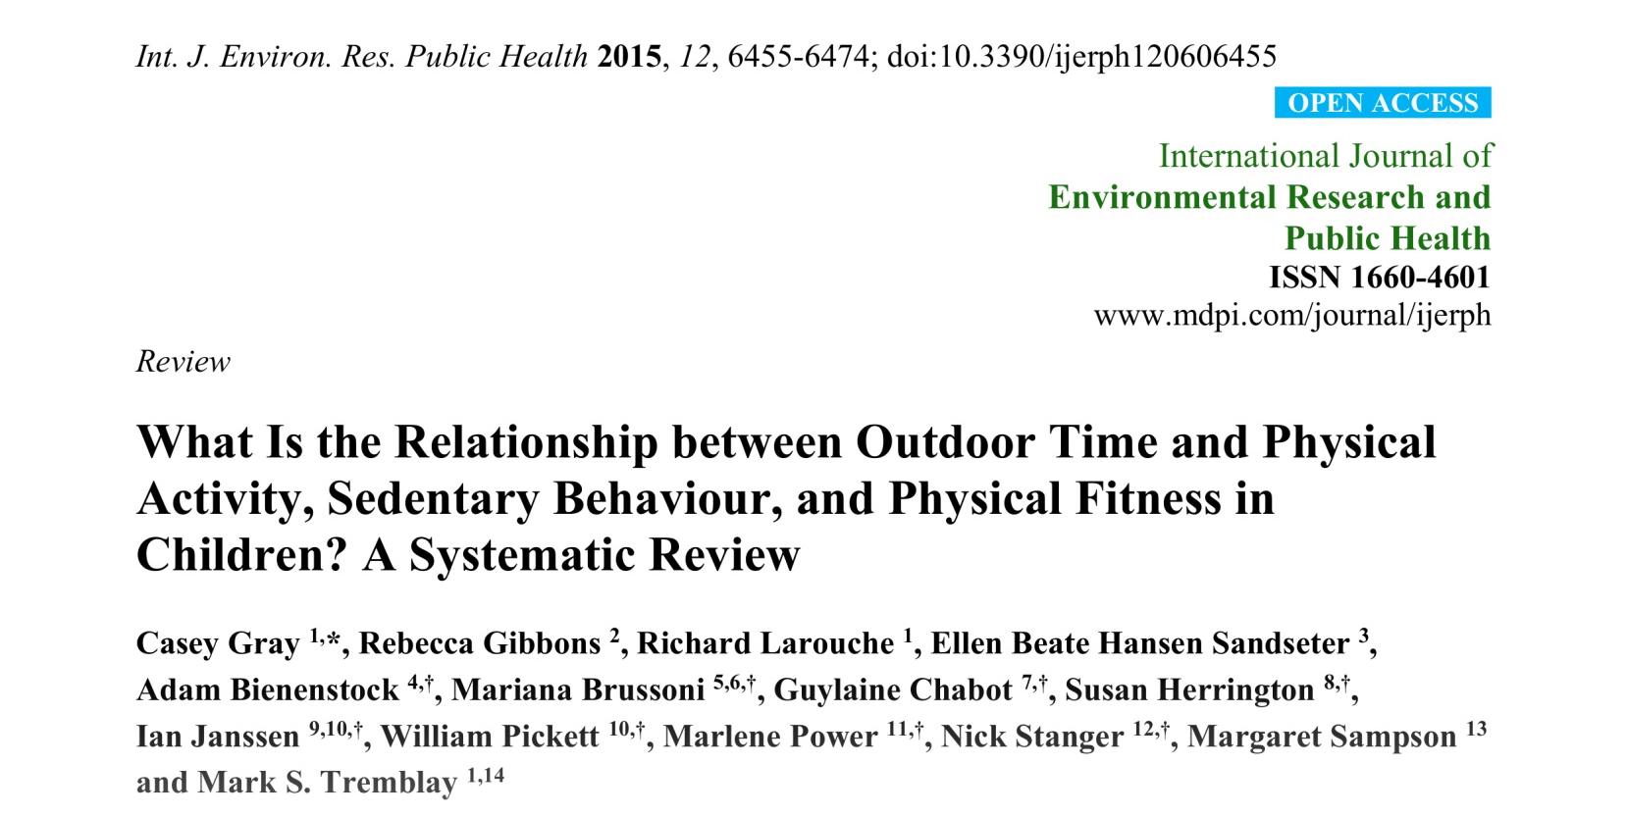
Systematic review (1)
www.mdpi.com/1660-4601/12/6/6455

Slide 20
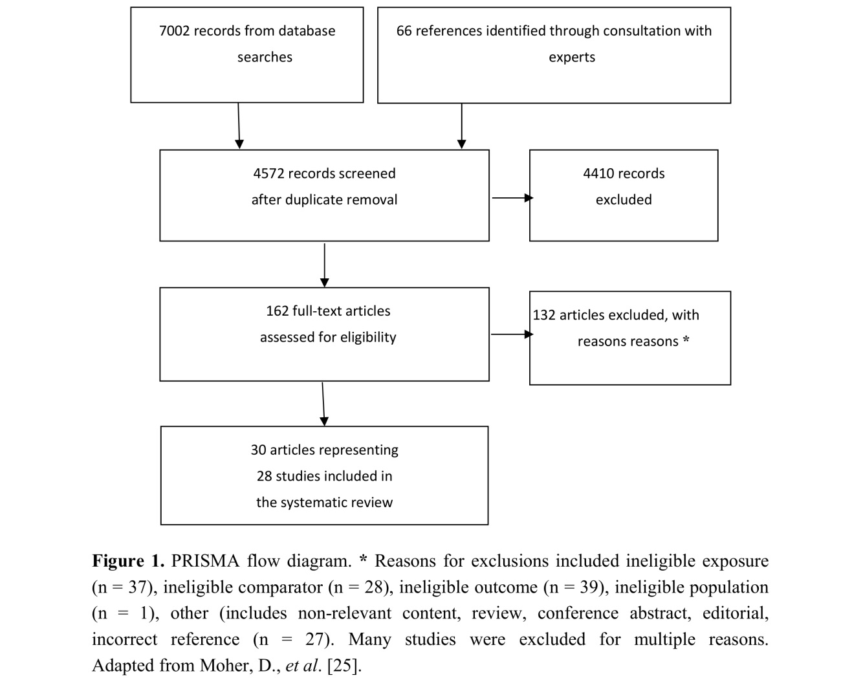
www.mdpi.com/1660-4601/12/6/6455

Slide 21
The objective of this systematic review was to examine the relationship between outdoor time and: (1) physical activity, (2) cardiorespiratory fitness, (3) musculoskeletal fitness, (4) sedentary behaviour; or (5) motor skill development in children aged 3–12 years.
Our systematic review, based on “very low” to “moderate” quality evidence, provides consistent evidence that children aged 3–12 years who spend more time outside are more active and less sedentary. All of the included studies reported positive effects on movement behaviours. Positive findings were apparent across ages, sexes and contexts (e.g., preschool, physical education, leisure time). Our findings highlight the importance of preserving time in children’s schedules for unstructured outdoor play and also for incorporating time outdoors within structured contexts like school and childcare as a means of promoting healthy active living.

Slide 22
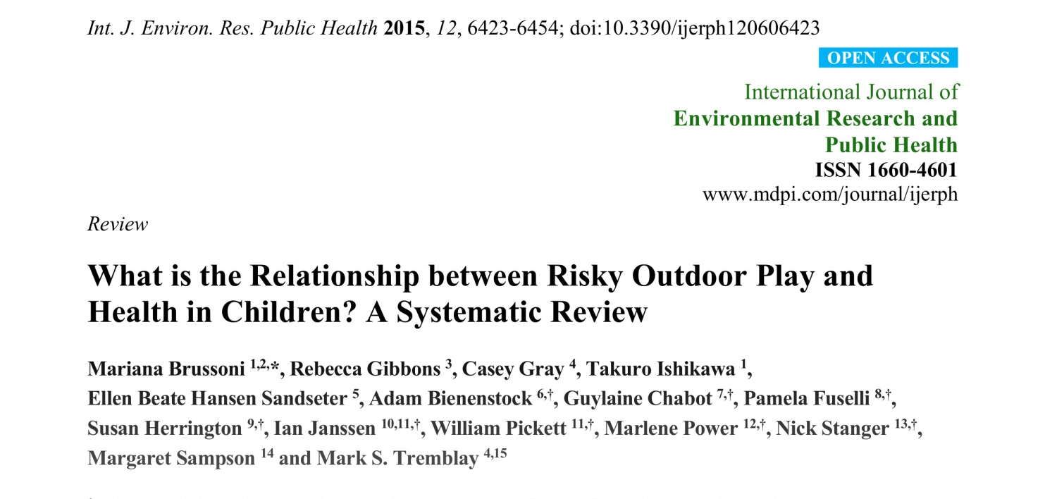
Systematic review (2)
www.mdpi.com/1660-4601/12/6/6423

Slide 23
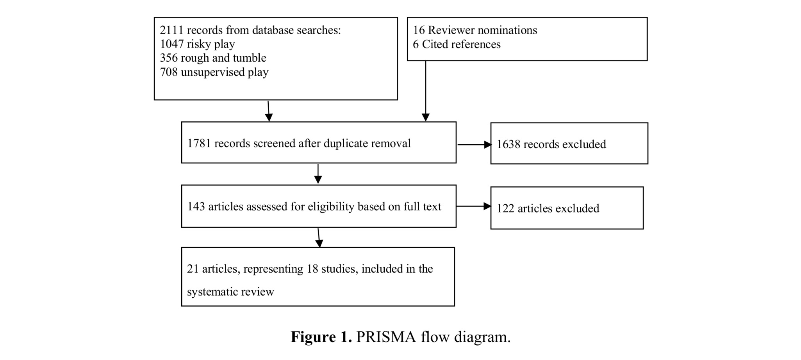
www.mdpi.com/1660-4601/12/6/6423

Slide 24
We sought to conduct a systematic review to examine the relationship between risky outdoor play and health in children, in order to inform the debate regarding its benefits and harms.
The systematic review revealed overall positive effects of risky outdoor play on a variety of health indicators and behaviours, most commonly physical activity, but also social health and behaviours, injuries, and aggression. The review indicated the need for additional “good quality” studies; however, we note that even in the face of the generally exclusionary systematic review process, our findings support the promotion of risky outdoor play for healthy child development.

Slide 25
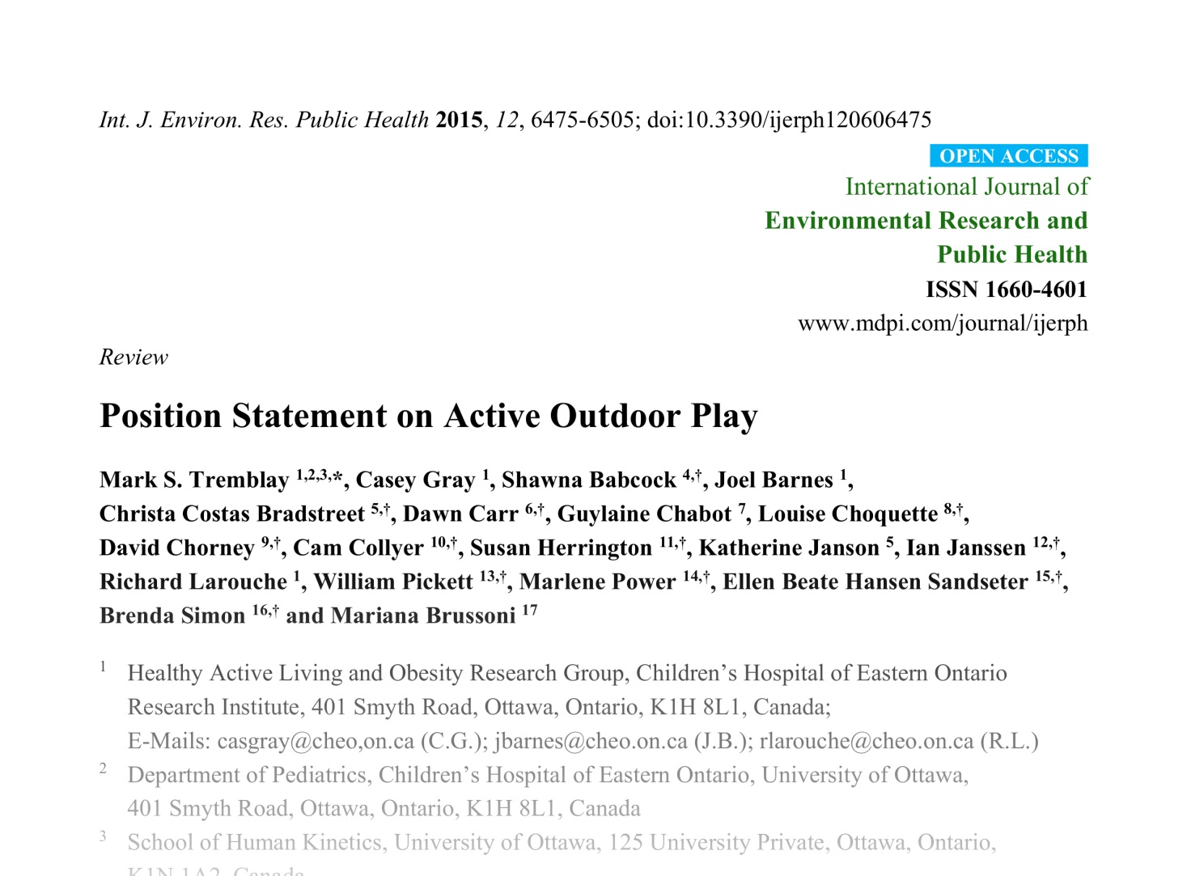
Process paper
www.mdpi.com/1660-4601/12/6/6475

Slide 26
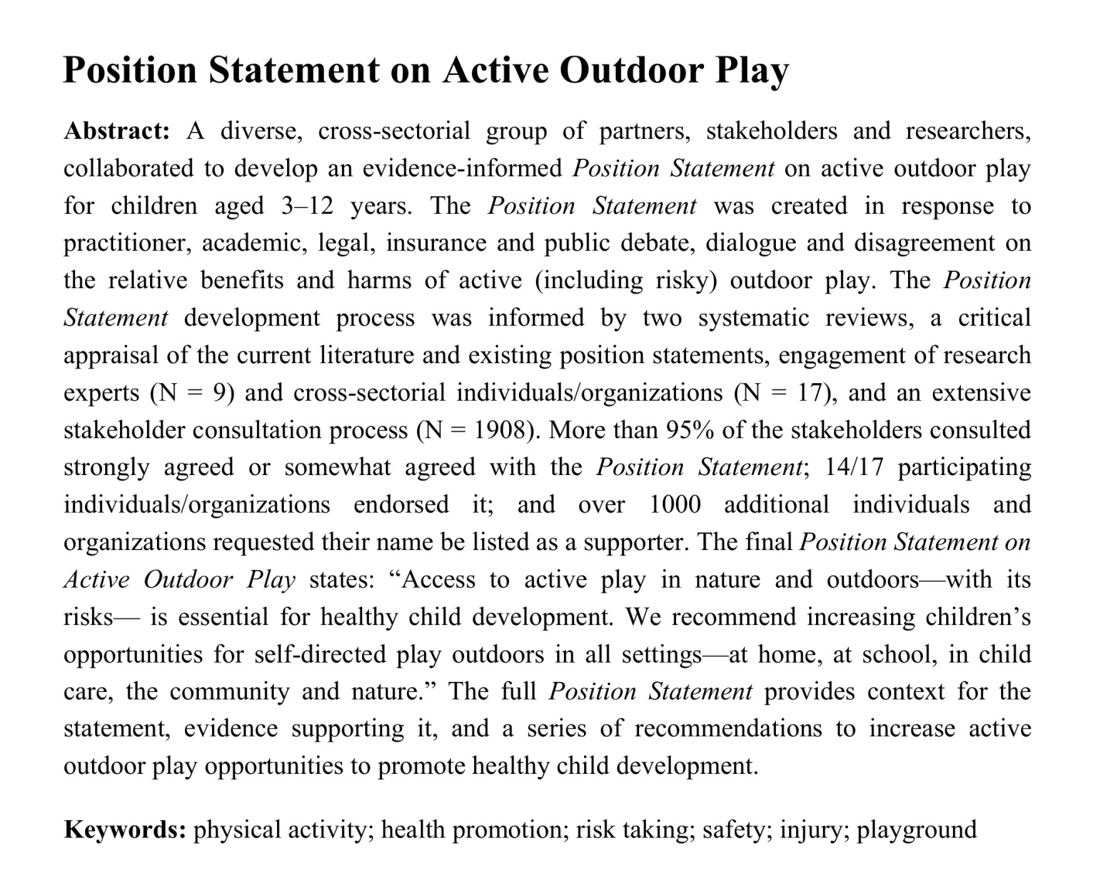
Process paper

Slide 27
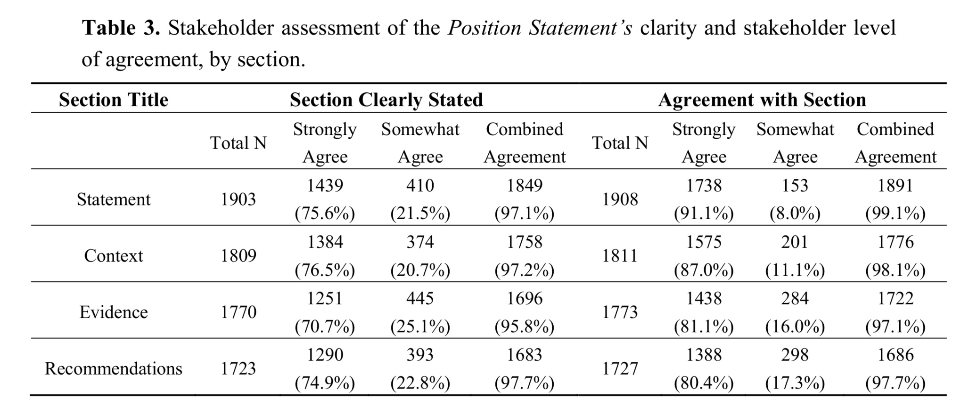
Process paper
www.mdpi.com/1660-4601/12/6/6475

Slide 28

Impact of the Position Statement on Active Outdoor Play
Legal Precedent
Judge Baird: Thompson v. Corp. of the District of Saanich, 09-30
  There is nothing negligent about playing grounders.
Municipal Policy
Peterborough & Region Public Health: Healthy, Complete Outdoor Play Spaces Policy Position
  Designated outdoor gathering spaces must support healthy free play.
  Explored connections between local injury statistics and existing outdoor play environments, context and research.

Slide 29
Impact of the Position Statement on Active Outdoor Play
School Culture Shift
A principal in the Renfrew County Catholic Board of Education has prioritized outdoor play and student engagement in her school
  Linked curriculum to outdoor active play.
  Dedicated school hallways to document input and share views on how and where students want to play.
  Engaged in addressing and eliminating barriers to active outdoor play in collaboration with the whole school community.

Slide 30
Impact of the Position Statement on Active Outdoor Play
Mental Health Resource
www.ementalhealth.ca; “Nature and Why It’s Essential For Kids’ Brains: Information for Parents and Caregivers”
  A handout that gives an overview of the importance of outdoor play, nature, and unstructured time;
  presents practical tips for following the recommendations.

Slide 31
Impact of the Position Statement on Active Outdoor Play
Charitable Sector Strategic Direction Shift
The Lawson Foundation; Outdoor Play Strategy
  Renewed strategic direction focused holistically on healthy child development.
  $2.7 million invested in 18 projects that support Canadian communities to increase children’s opportunities for outdoor play.

Slide 32
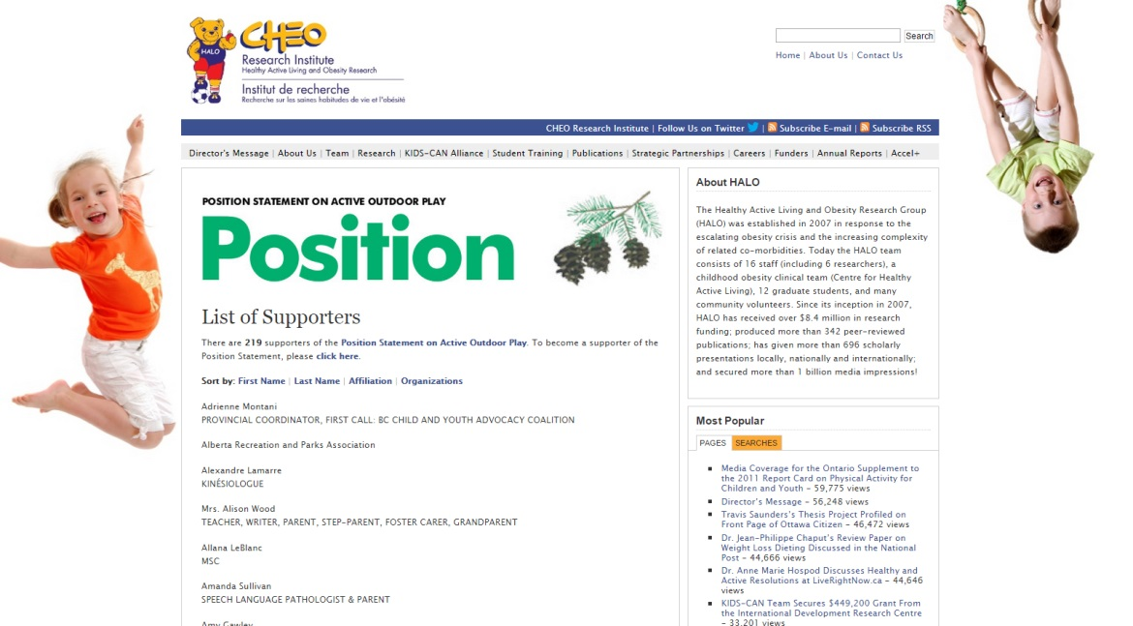
Support the position statement
www.haloresearch.ca/outdoorplay

Slide 33
Report Card Evaluation Survey

Slide 34
Report Card Evaluation Survey

Slide 35
Report Card Evaluation Survey

Slide 36
Report Card Evaluation Survey

Slide 37
Report Card Evaluation Survey

Slide 38
Report Card Evaluation Survey

