Slide 1
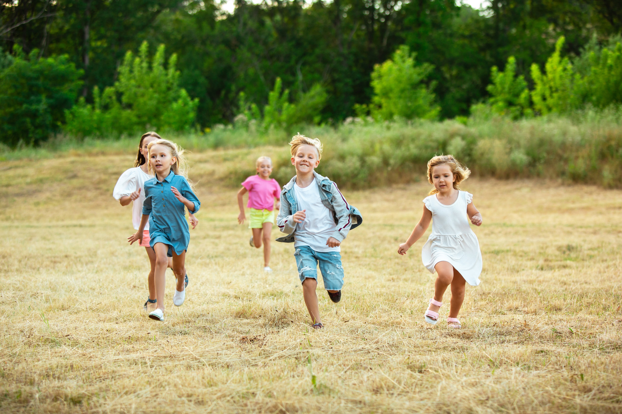

Correlates of Outdoor Time in Minority Children in Canada
For boys: Higher independent mobility, warmer outdoor air temperature, living in urban (vs. suburban) areas, having a mobile phone, older parents, or parents who biked to work
For girls: Higher parental education, lower parental concerns about neighborhood safety and social cohesion
478 grade 4-6 children speaking a non-official language at home in 3 sites (Ottawa, Trois-Rivières, Vancouver)
<a href="https://www.freepik.com/free-photo/kids-children-running-meadow-summer-s-sunlight_9405479.htm?query=children%20playing%20outdoors&collectionId=2896&&position=14&from_view=collections">Image by master1305</a> on Freepik

