Slide 1



The 2025 Position Statement on Active Outdoor Play
A Project led by Outdoor Play Canada

Slide 2
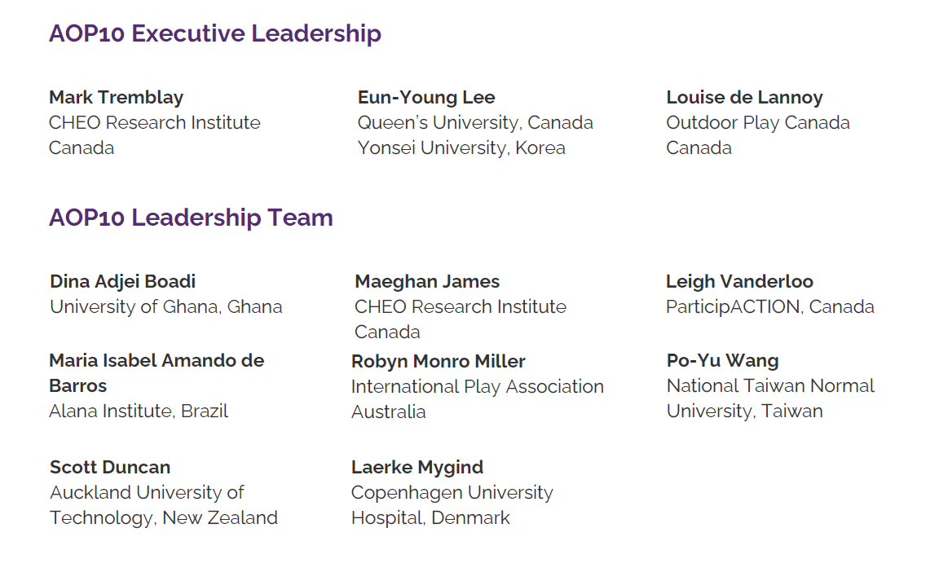

Slide 3
“I have seen public health messages that advise people to avoid going outdoors at dawn and dusk during peak mosquito hours, in the early morning and late afternoon during peak traffic hours, and from late morning to late afternoon during peak sunlight hours. And of course, children should not go outdoors if it is hotter than 30°C, colder than −20°C, raining, and/or dark outside. If parents and caregivers paid attention to all of these messages, they would believe it is never safe for children to go outside and be active! These messages that public health bodies convey about the outdoors need to change from avoidance to adaptation and mitigation. For instance, it if is raining out, kids should not be told to stay indoors. Rather, they should be encouraged to put on a raincoat and rubber boots and go outside and jump in a puddle.”
Janssen. CJPH 107(6):e497-e499, 2016
Janssen. CJPH 107(6):e497-e499, 2016

Slide 4

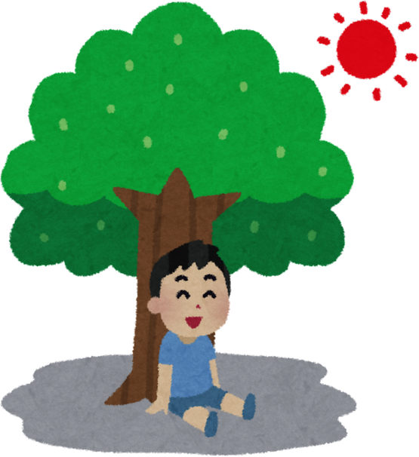
Why should we care about outdoor play?
Mental Health
Emotional Health
Physical Health
Social Health
Spiritual Health
(Brussoni et al., 2015; de Lannoy et al., Under Review, Gray et al., 2015; James et al., Under Review, Tremblay et al., 2015)

Slide 5

Informed by 2 systematic reviews
Interpreted by Canadian experts from 14 organizations and reviewed by >1,600 stakeholders.
To date, there are 469 supporters of the Position Statement, including endorsement by the Council of Chief Medical Officers of Health
Research-grade report: www.mdpi.com/journal/ijerph.
Public facing document: https://www.outdoorplaycanada.ca/portfolio_page/the-2015-position-statement-on-active-outdoor-play/

Slide 6
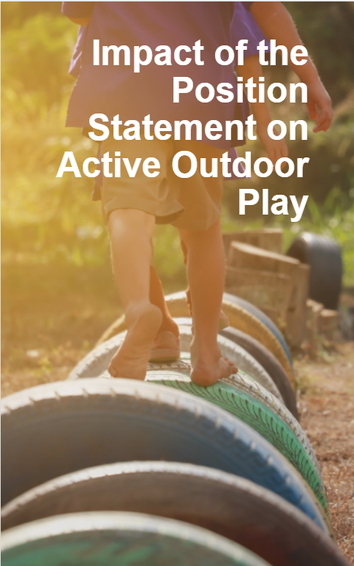

Legal Precedent
Municipal Policy
School Culture Shift
Mental Health Resource: ementalhealth.ca
Charitable Sector Strategic Direction Shift
Wide Support and Replication
Creation of Outdoor Play Canada (www.outdoorplaycanada.ca)

Slide 7



Update of the Active Outdoor Play Position Statement
In September 2025, it will be 10 years since the launch of the Position Statement on Active Outdoor Play
To mark this milestone, an international group of outdoor play leaders, representing every inhabited continent have come together to develop an updated 2025 Position Statement.
This update extends the original Position Statement by being global in scope and inclusive of all ages, while broadening the scope of content by exploring the benefits of active outdoor play for people (of all ages, cultures and abilities), communities, environments, and the planet.
This project has been funded by:

Slide 8

Leverage active outdoor play to advance the United Nations Sustainable Development Goals
Eun-Young Lee
Associate Professor, School of Kinesiology & Health Studies, Queen’s University
Affiliated Investigator, Children’s Hospital of Eastern Ontario Research Institute

Slide 9
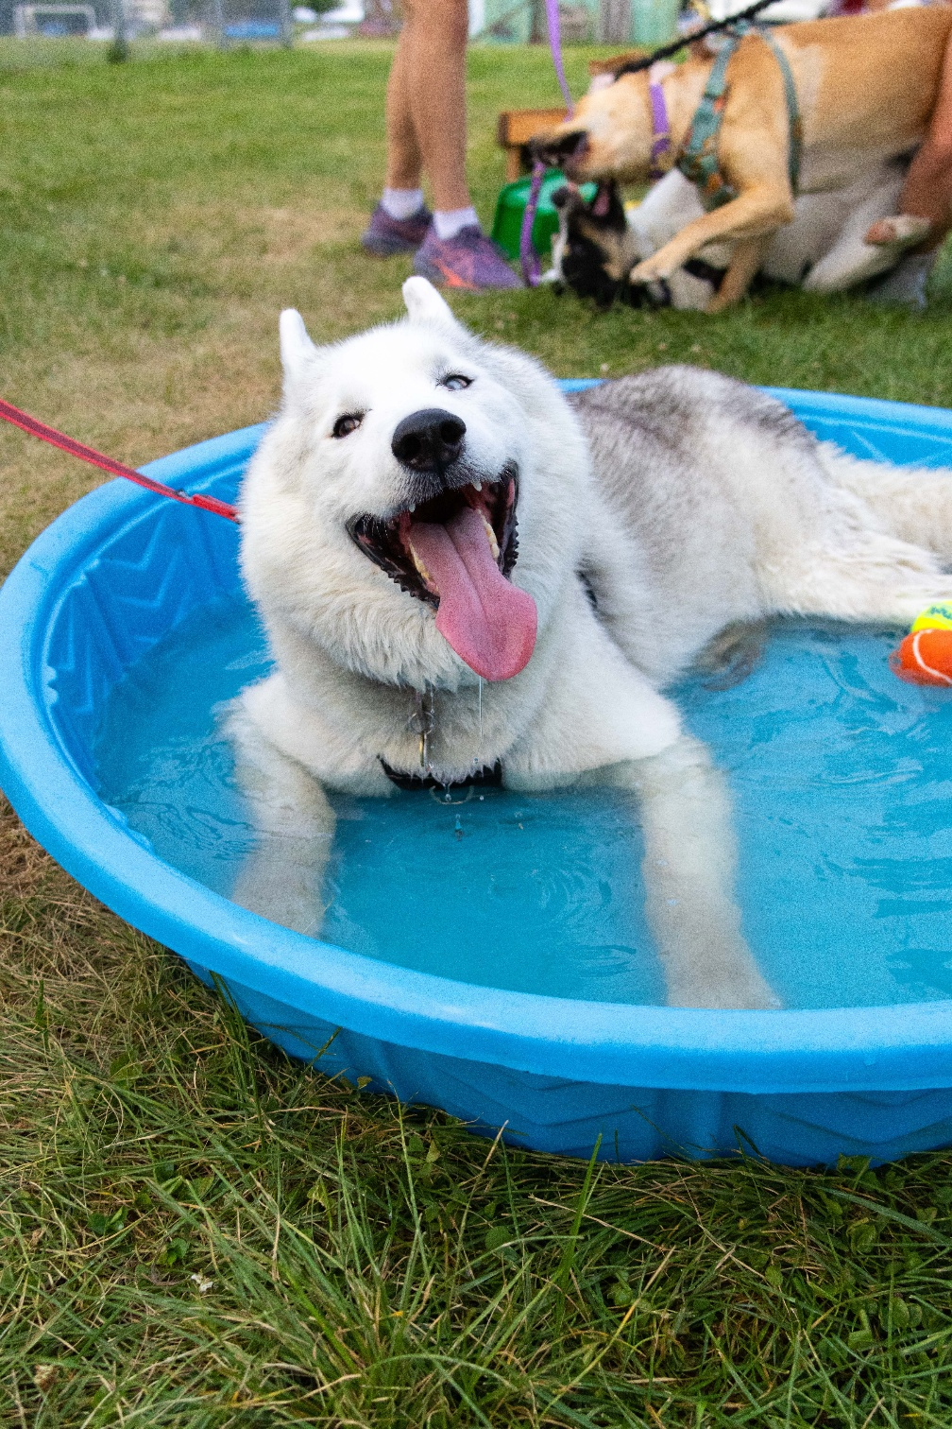
10 years and 18 systematic and narrative reviews later… here is what we did and what we found

Slide 10


AOP10 Leadership Group & Steering Committee
An 11-person leadership group and 143-person steering committee with representation from every inhabited continent across 32 countries

Slide 11
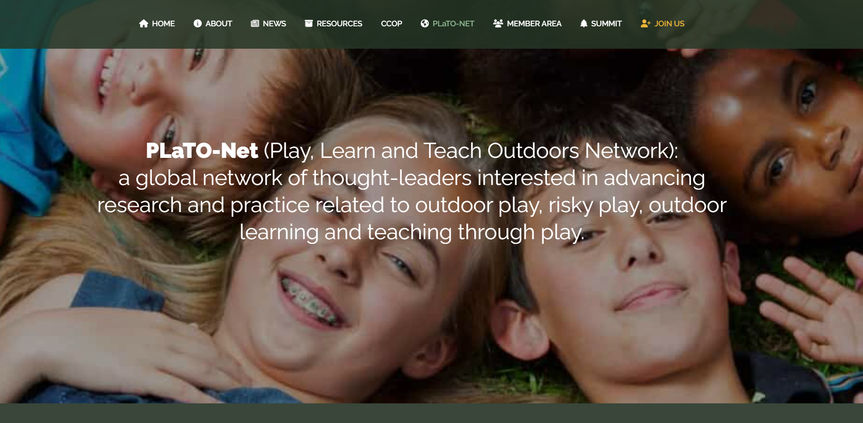

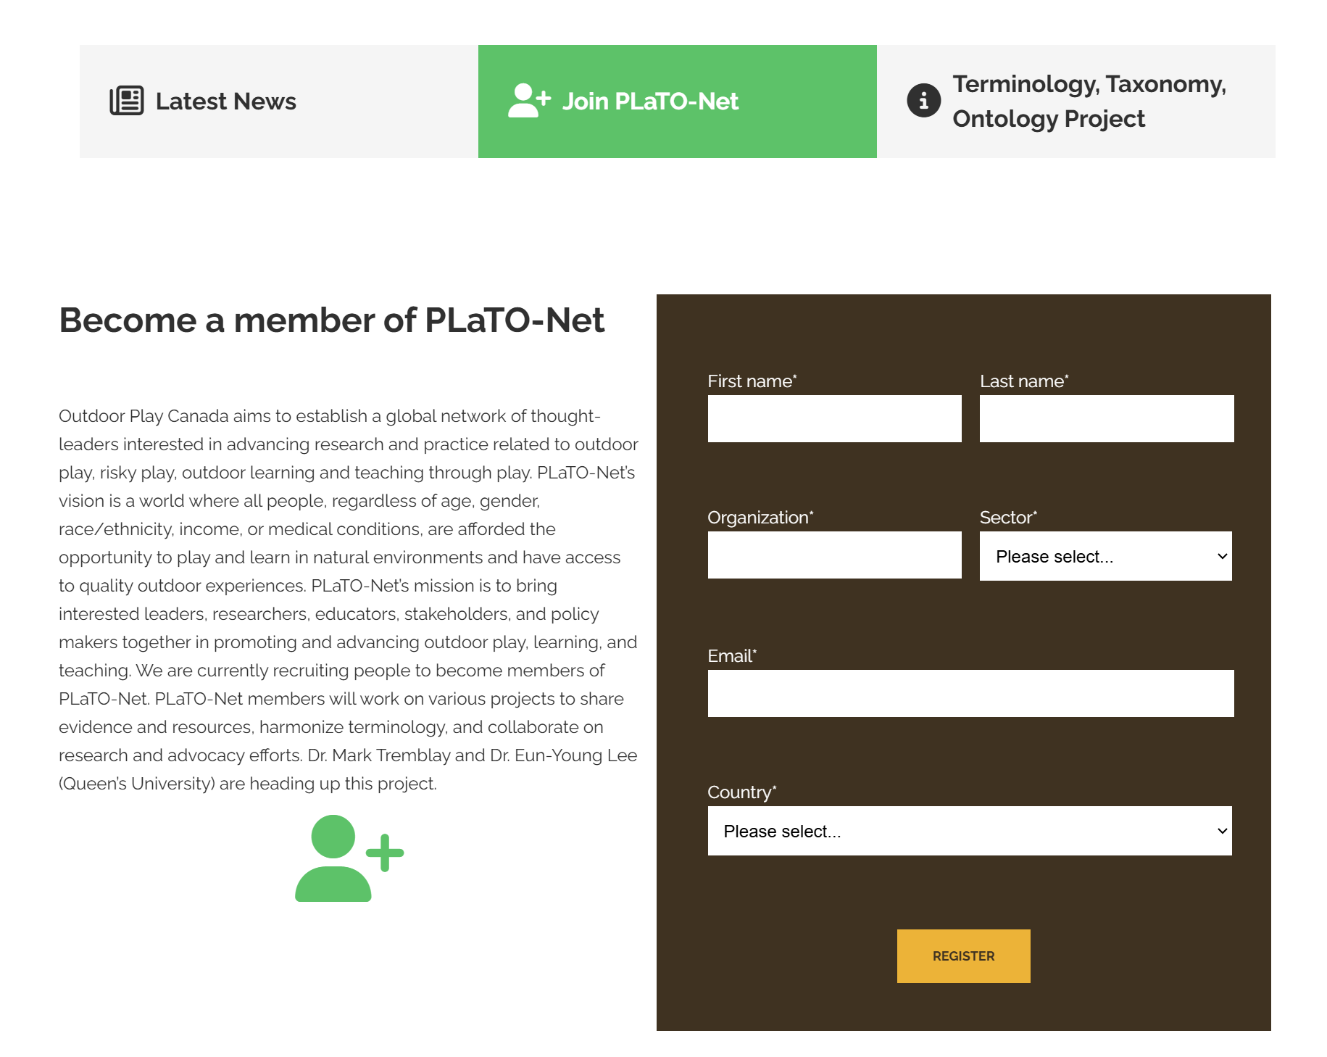
A global network of thought leaders interested in advancing research and practice related to outdoor play, learning and teaching.
700 members from 61 countries
https://www.outdoorplaycanada.ca/plato-net/

Slide 12
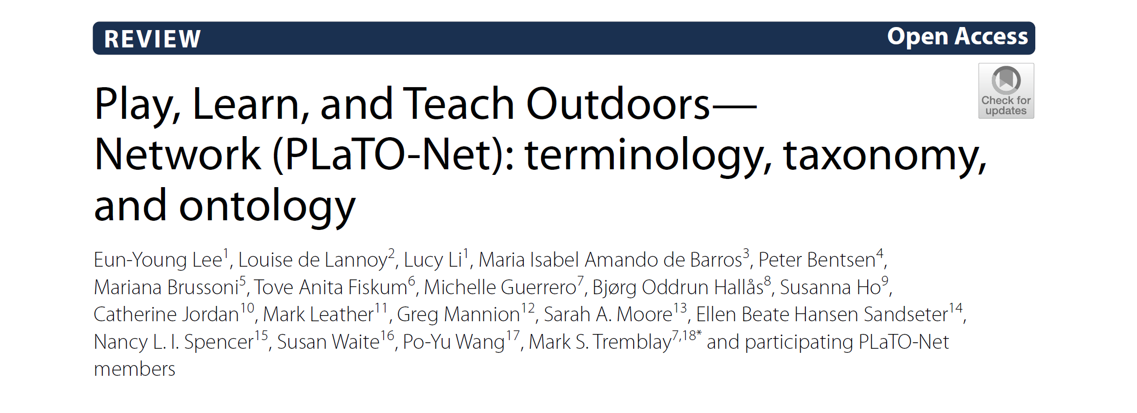

PLaTO Terminology, Taxonomy and Ontology Published Paper (open access)
Active Outdoor Play: Voluntary engagement in activity that takes place outdoors and involves physical activity of any intensity, and is fun and/or rewarding and usually driven by intrinsic motivation

Slide 13

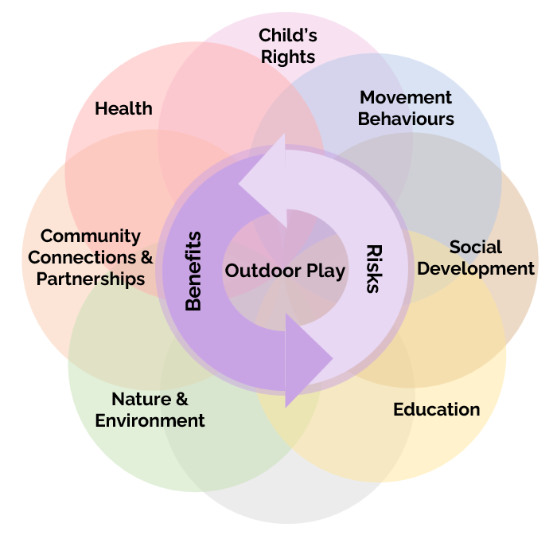
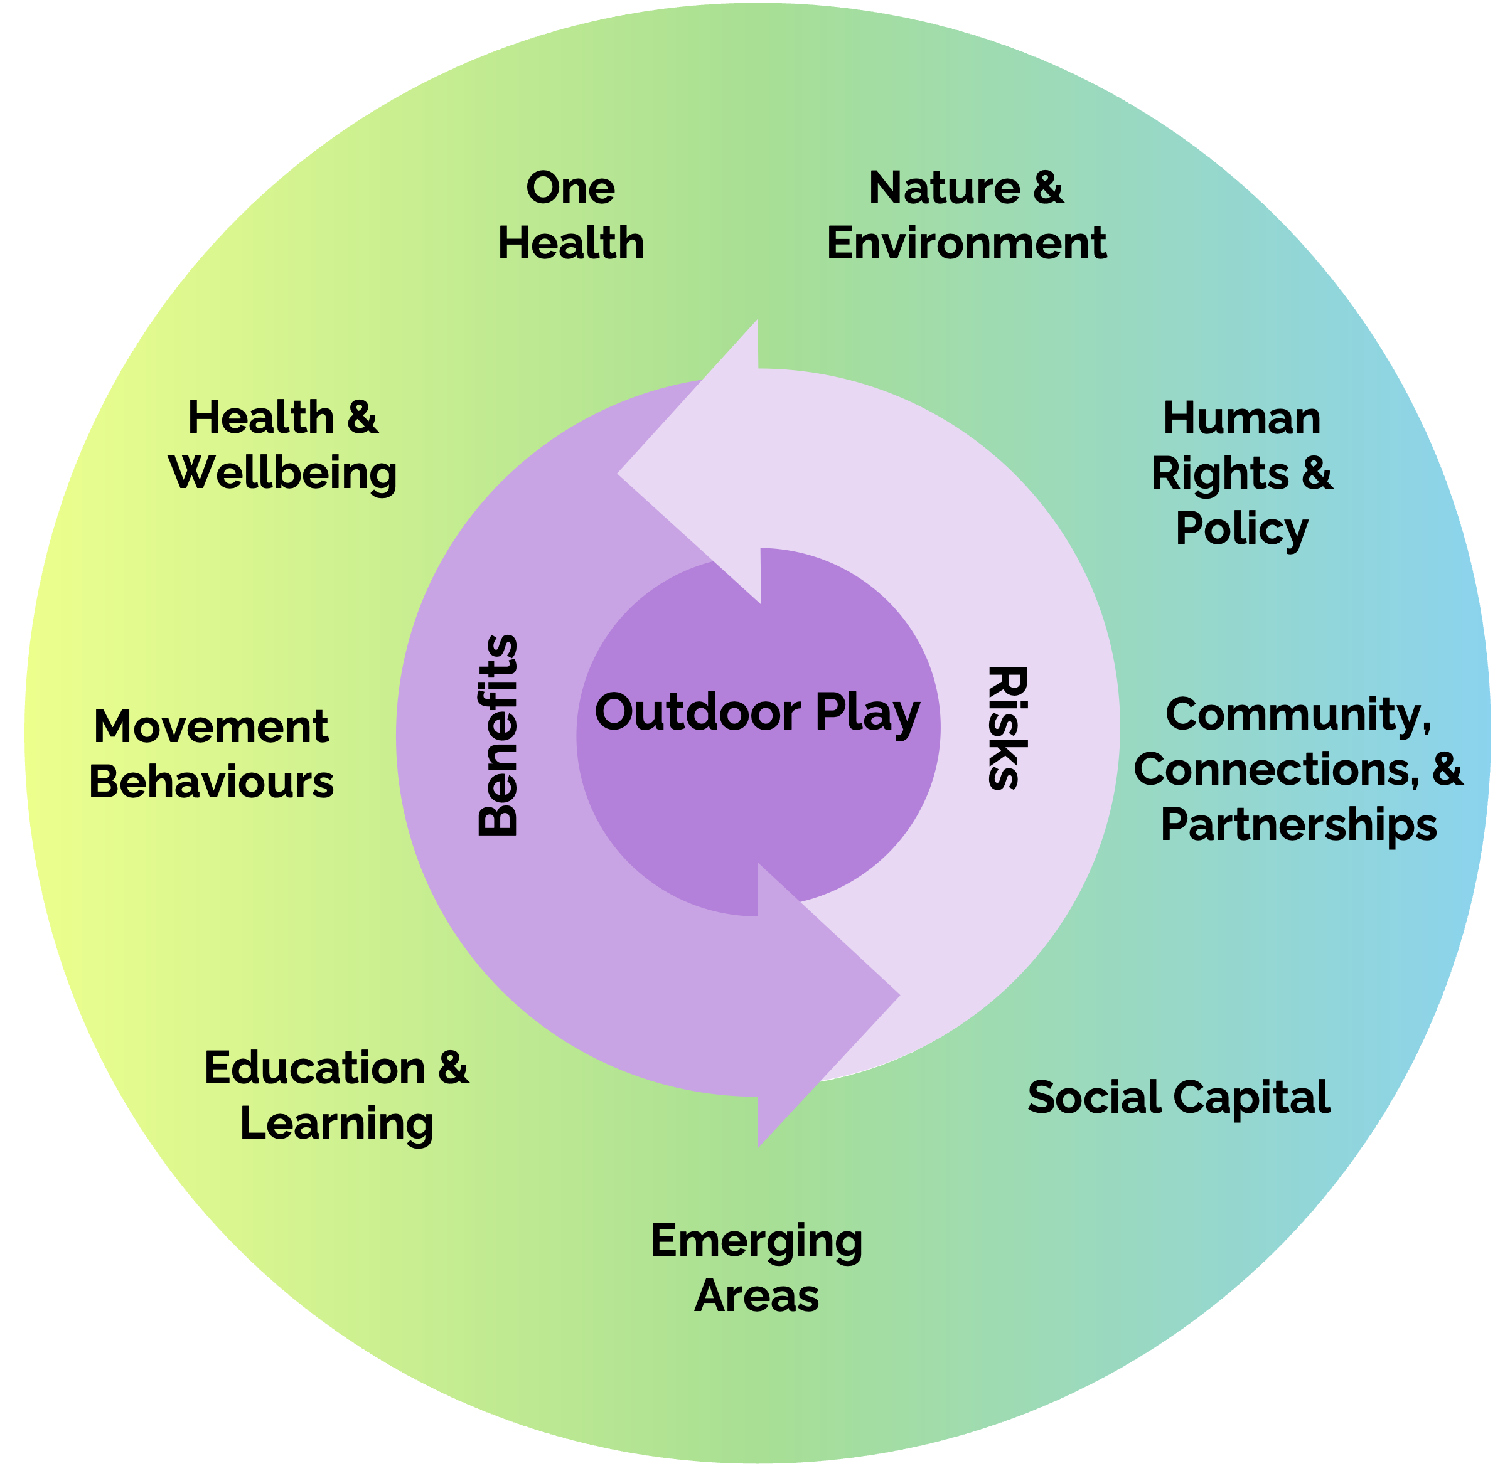







Evidence Synthesis Process Informing the AOP10 Position Statement
Environmental Scan
Text Mining
Expressions of interest
Draft Conceptual Framework + Consensus Survey
Conceptual Framework Finalized
Evidence Synthesis
93% (98/105) response rate
90% agreement
87 comments
Linked Network Analysis

Slide 14
Evidence Synthesis
2 systematic reviews
1 narrative review
1 umbrella review
1 umbrella review, 1 systematic review, 1 scoping review
1 systematic review and meta-analysis
1 grey literature review
1 systematic review
2 systematic reviews

Slide 15
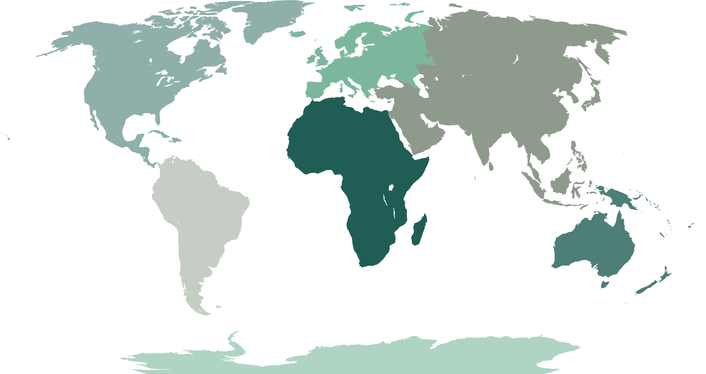

Geographic Region Reviews
UN geographic regions
Africa
Asia
Europe
Latin America and the Carribean
Northern America
Oceania
Geographic reviews conducted to identify the state of research, leadership, policy, and culture surrounding active outdoor play in each region

Slide 16
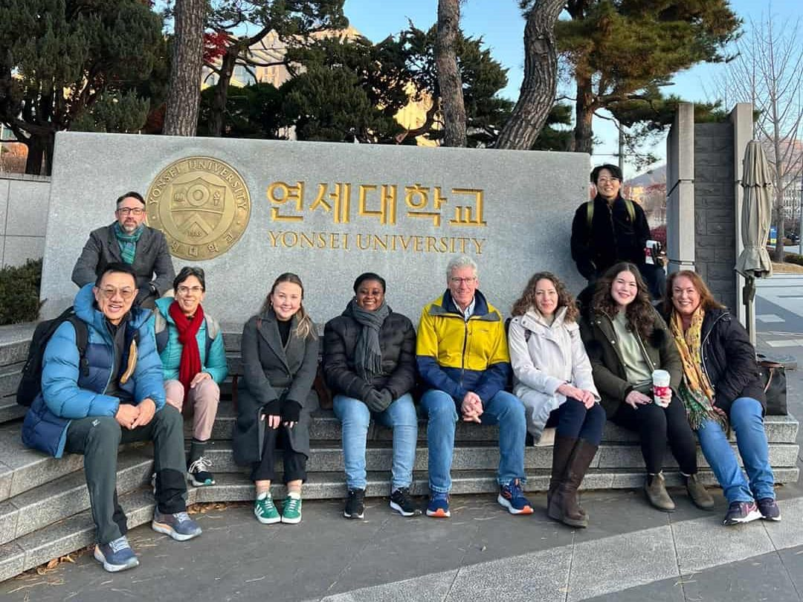
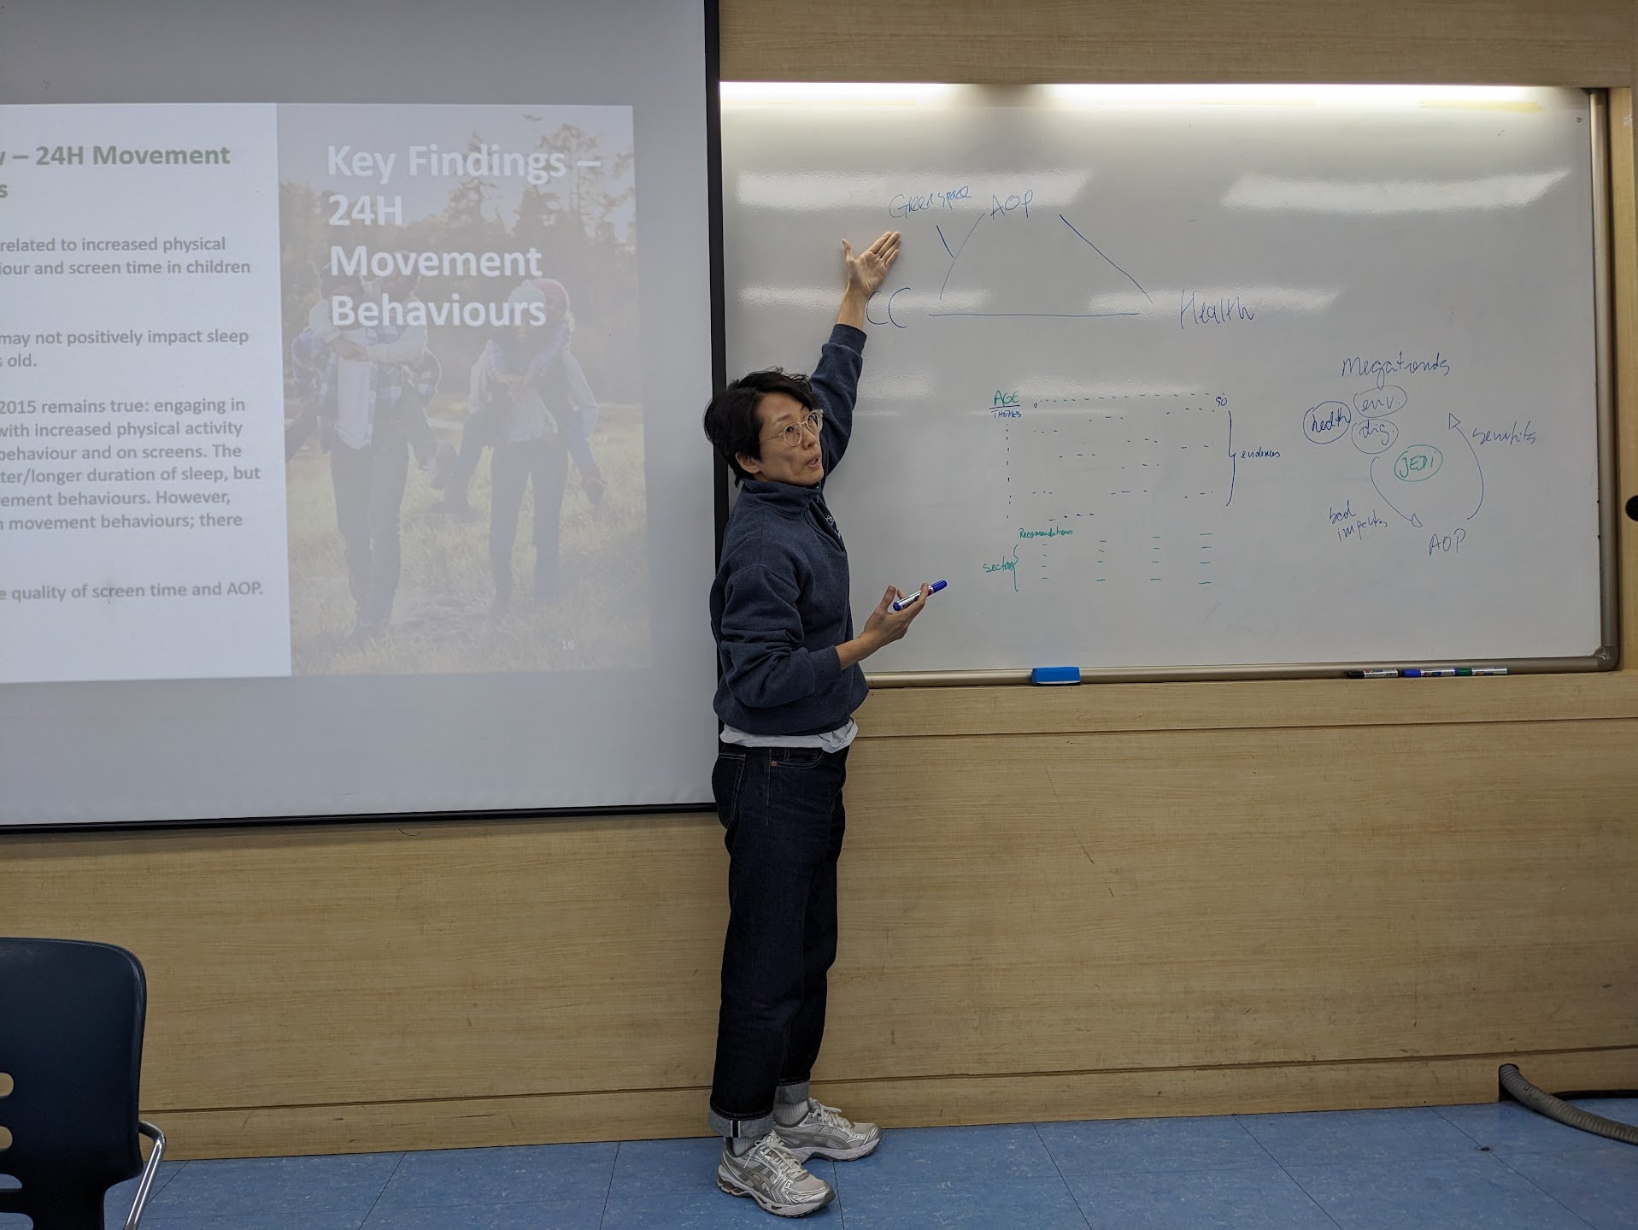
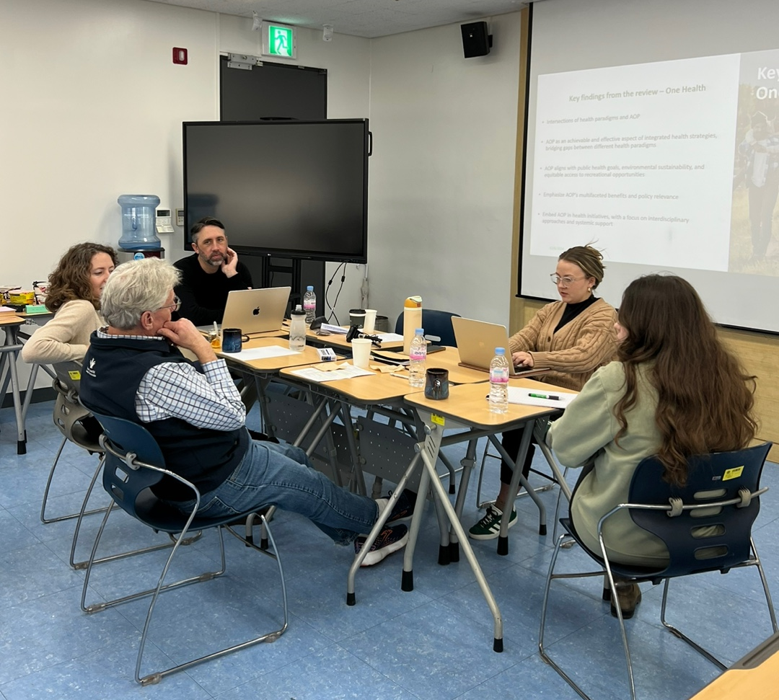
2.5 days of AOP10 Leadership Group meetings in Seoul, South Korea
Review of all review material collected across the nine conceptual model themes
Development of the first draft of the 2025 Position Statement on Active Outdoor Play

Slide 17
Evidence Synthesis Process Informing
the AOP10 Position Statement
January 2025
February 2025
March-April 2025
Draft Position Statement Developed
Consensus Survey 1
Steering Committee
Consensus Survey 2
Steering Committee
Consensus Survey 3 Global Survey
(all 6 UN official languages)
94% (130/139) response rate
95% agreement
86 comments
80% (111/139) response rate
99% agreement
75 comments
97% agreement
269 comments

Slide 18


The 2015 Position Statement stated:
“Access to active play in nature and outdoors – with its risks – is essential for healthy child development. We recommend increasing children’s opportunities for self-directed play outdoors in all settings – at home, at school, in child care, the community and nature.”
This update extends the original Position Statement by being:
Global in scope
Inclusive of all ages
Broadening the scope of content by exploring the benefits of active outdoor play for people (of all ages, cultures and abilities), communities, environments, and the planet

Slide 19


Notes:
Today, I have the honour to present the 2025 Position Statement on Active Outdoor Play! And its supportive evidence statements

Slide 20
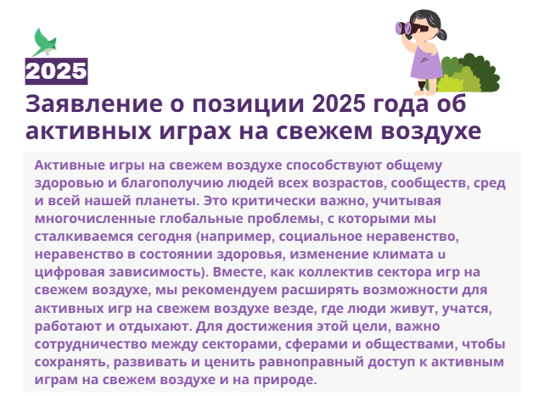



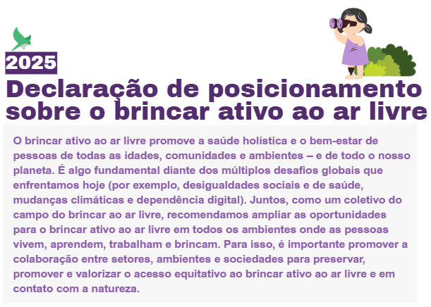
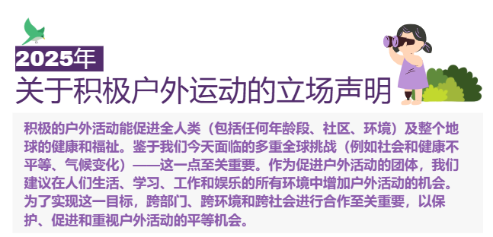
Available in all 6 UN Languages!
Notes:
Want to see the Position Statement translated to your language? Visit https://www.outdoorplaycanada.ca/aop10/

Slide 21
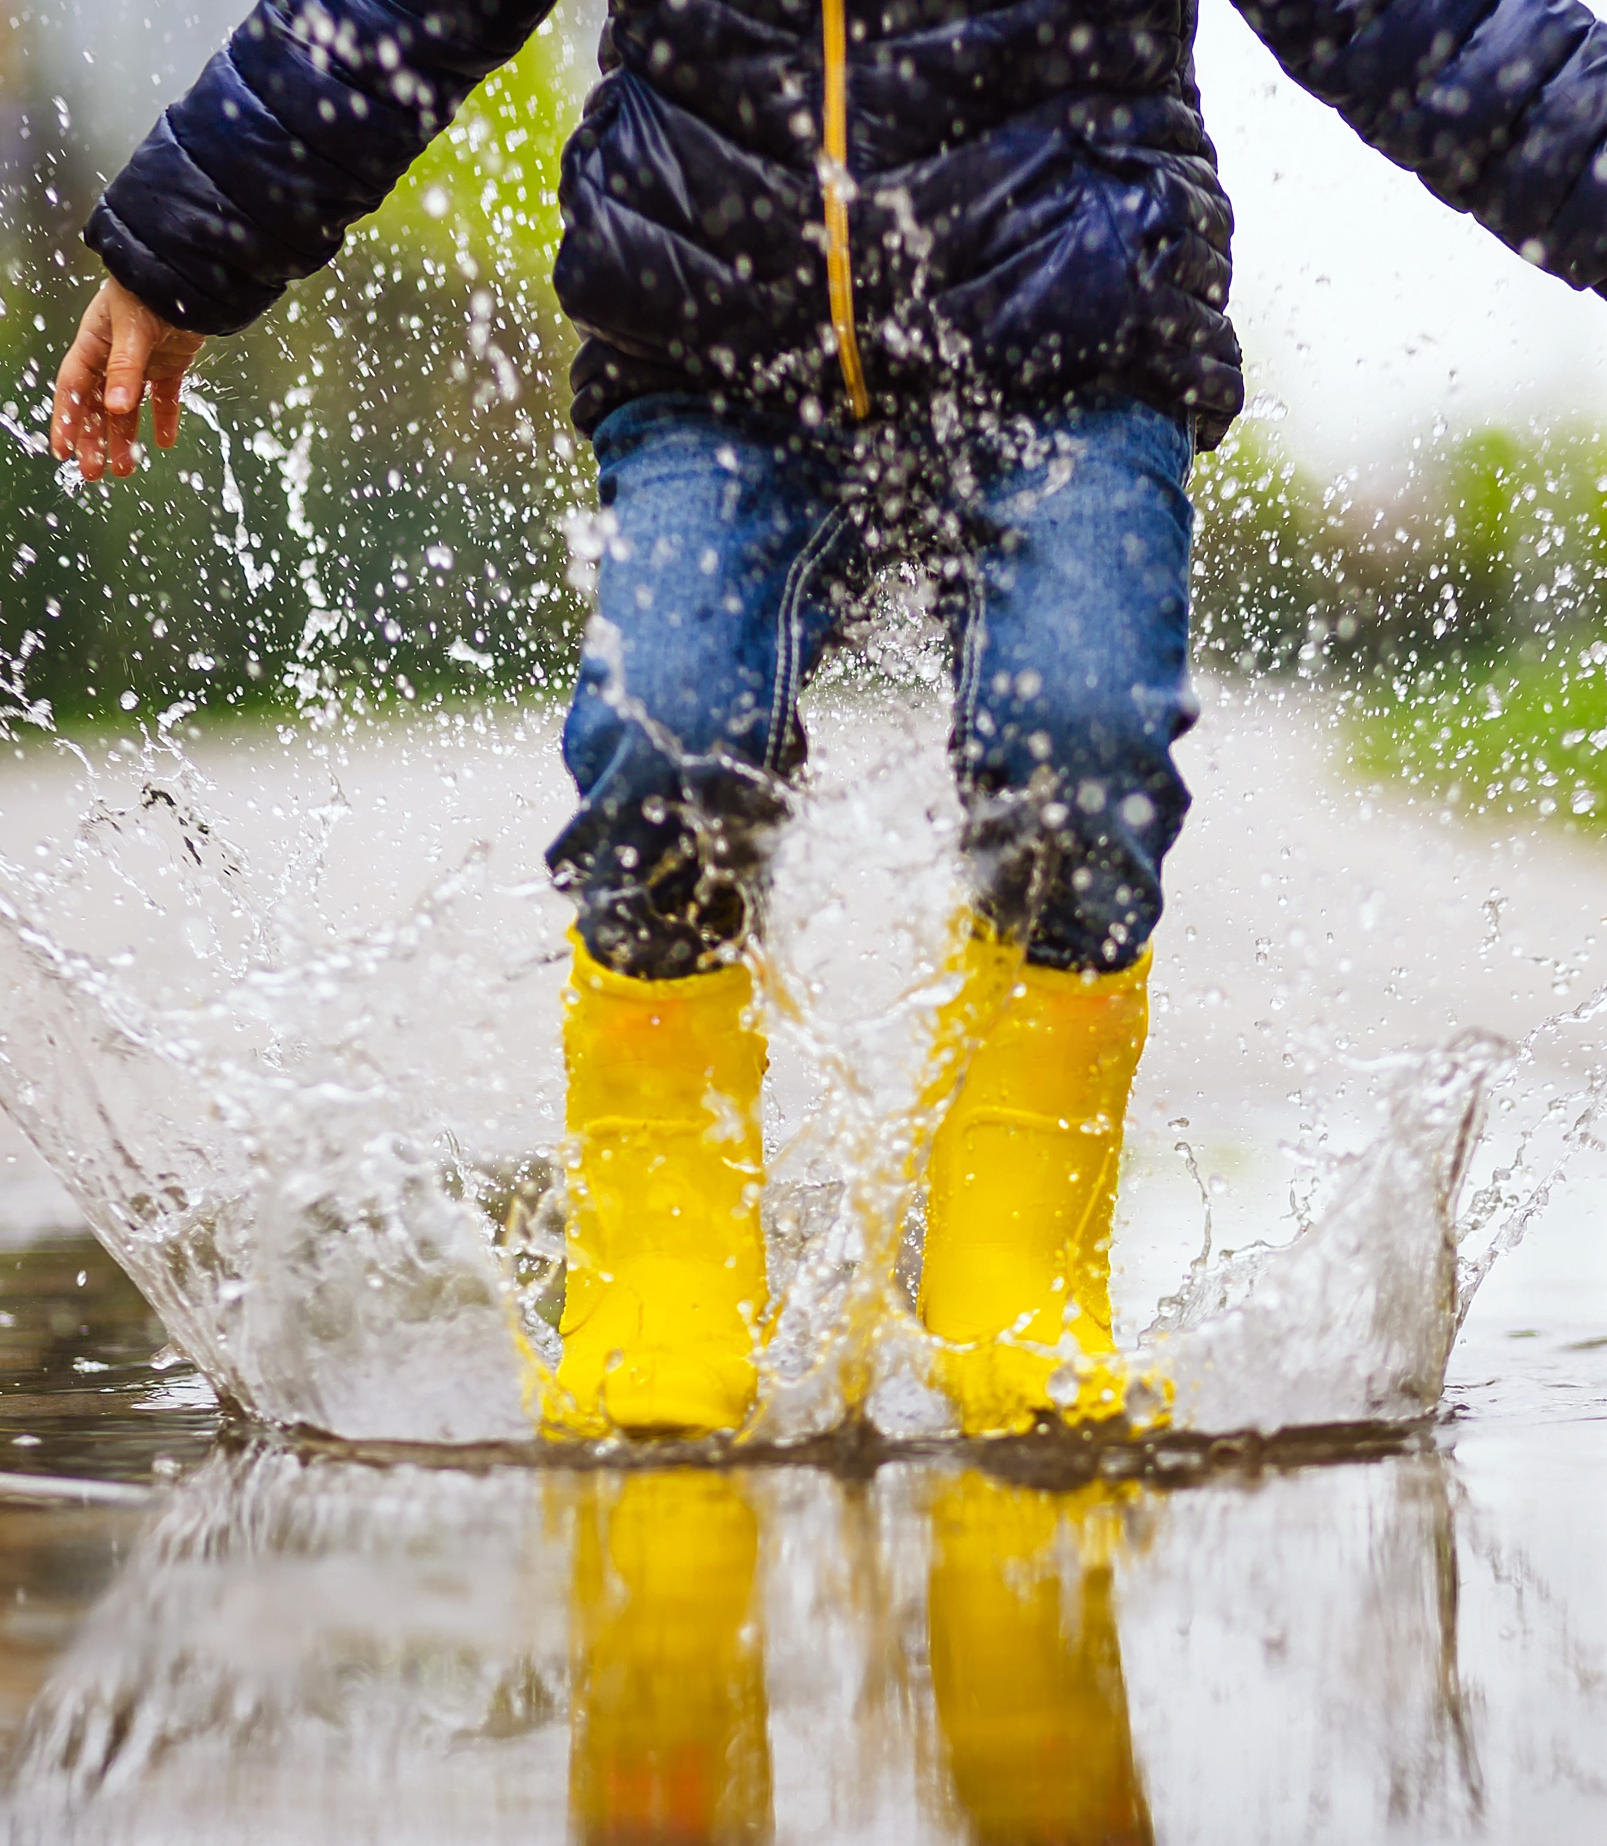
Evidence Statements:
Active outdoor play…
Helps us move more, play longer, and sleep better
Catalyzes sustaining health and well-being
Promotes confidence, naturally
Offers a pathway to a happier, heathier planet
Builds climate resilience and stewardship for a sustainable future
Connects communities
Facilitates diverse learning opportunities
reduces excessive indoor time
Notes:
Our evidence statements highlight the many ways active outdoor play benefits people and the planet.

Slide 22
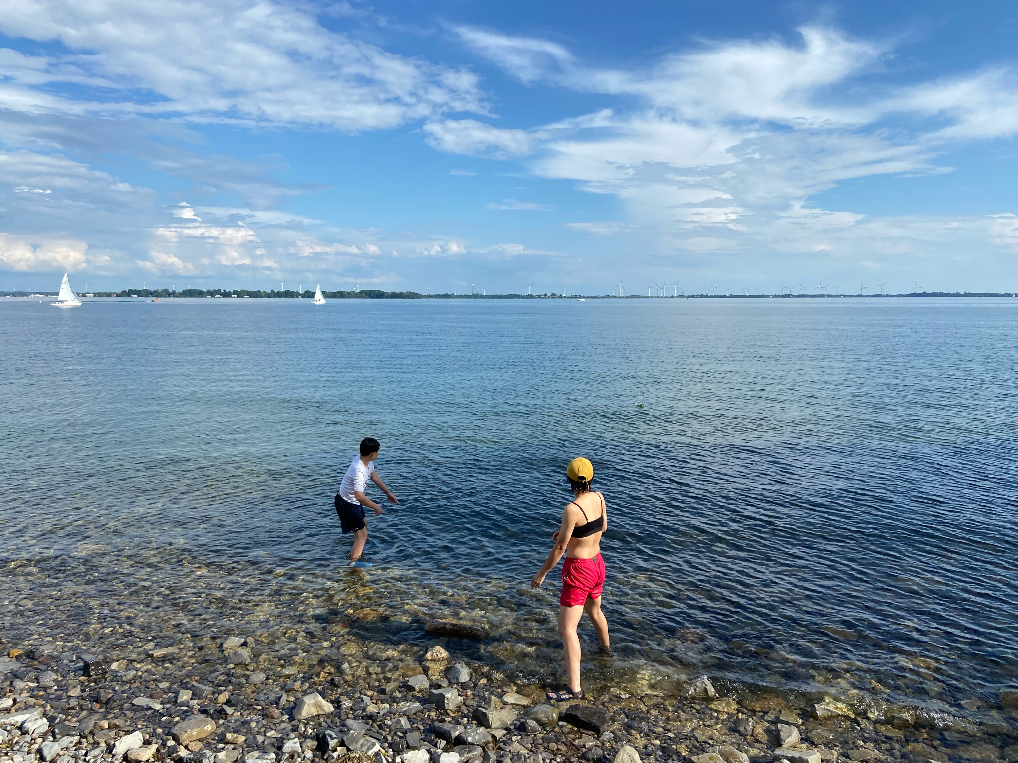
Active outdoor play helps us move more, play longer, and sleep better
Notes:
Evidence shows that when we play outdoors, we engage in more physical activity and less sedentary behavior and screen time, leading to better sleep.
Outdoor environments can encourage individuals to engage in spontaneous, fun activities.

Slide 23
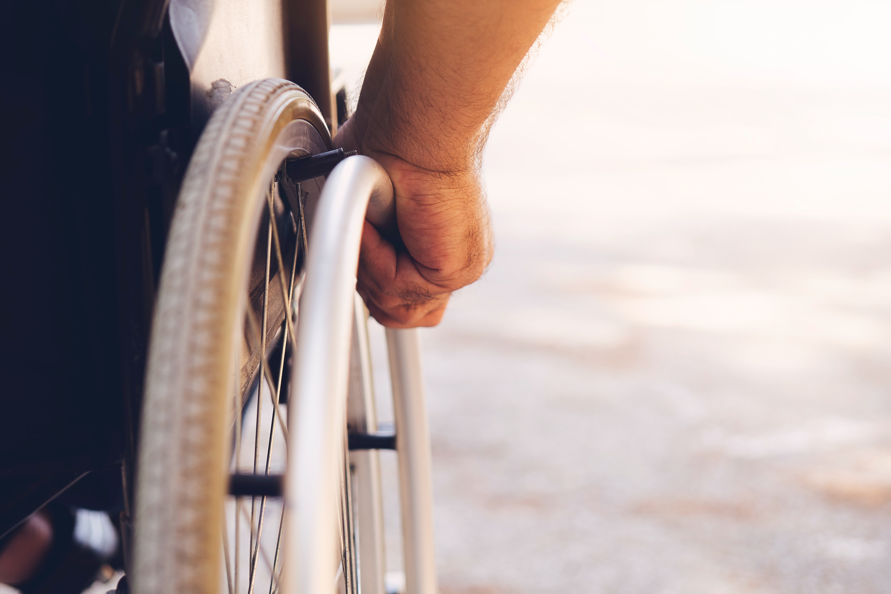
Active outdoor play is a catalyst for sustaining health and well-being
Notes:
Active outdoor play can enhance physical, mental, social, spiritual health and well-being
Playing outdoors offers an opportunity to connect, explore, and engage in healthy and enriching ways.^{34,36,38,39}

Slide 24
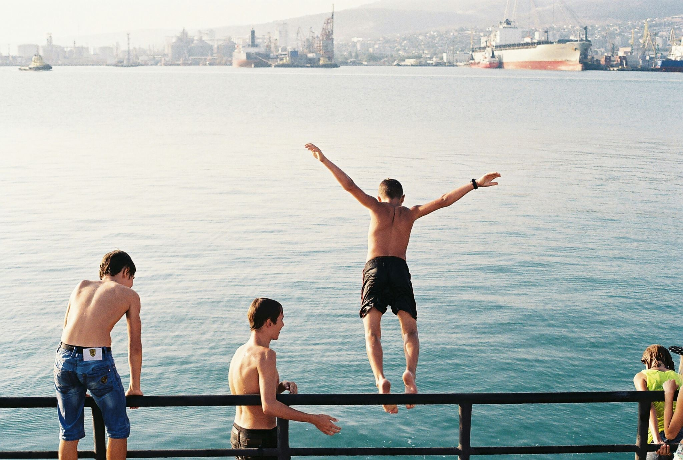
Active outdoor play promotes confidence, naturally
Notes:
Outdoor environments provide a dynamic space for playful adventures and risk-taking – an essential ingredient for healthy development^{3,35,44} and aging.⁴⁵⁻⁴⁷
Engaging in active outdoor play that is challenging helps build confidence, resilience, and problem-solving skills, while promoting agency, well-being, and physical literacy.^{3,35,48-52}

Slide 25
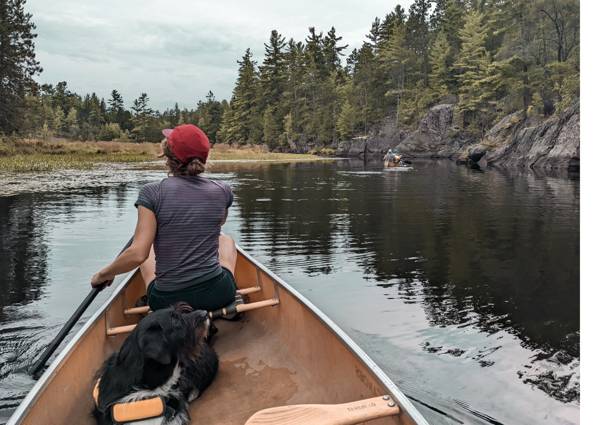
Active outdoor play offers a pathway to a happier, healthier planet
Notes:
Active outdoor play can bridge multiple sectors including public health, education, recreation, and the environment, while recognizing the interconnectedness of human, animal, and environmental well-being.⁵³⁻⁵⁷
AOP fosters relationships with nature, contributing to healthier communities, stronger ecosystems, and a more sustainable planet.^{47,53,58,59}

Slide 26
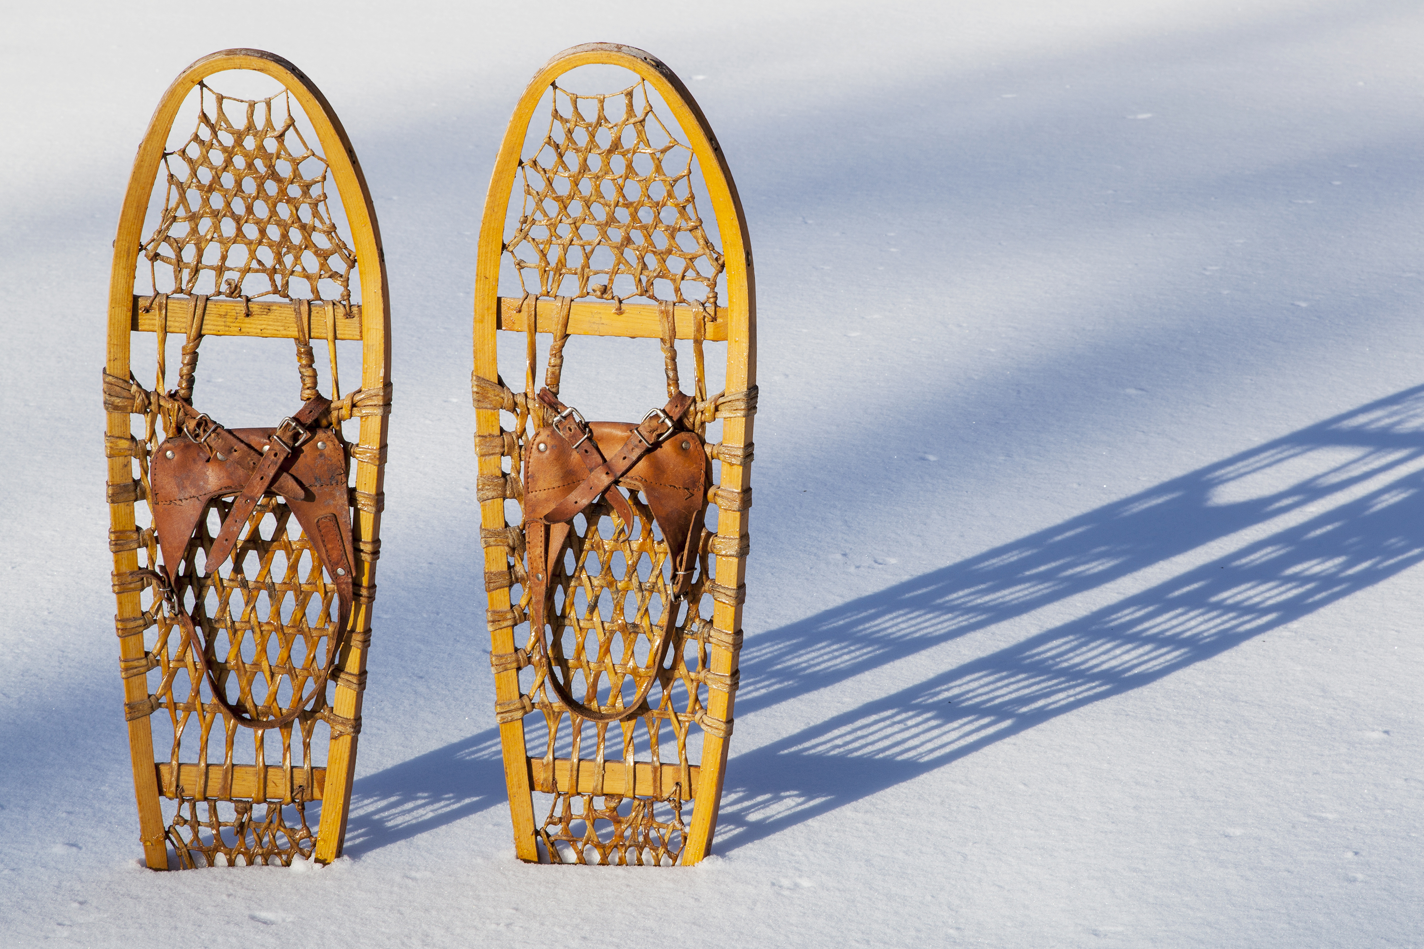
Active outdoor play builds climate resilience and stewardship for a sustainable future
Notes:
Engaging in active outdoor play nurtures a deepened connection with nature and caring for our natural world.⁶⁰⁻⁶⁴
Climate change may threaten opportunities for active outdoor play, but when active outdoor play is part of daily life, it can foster a culture where people of all ages play, learn, grow, and thrive together while adapting to and building resilience for climate change.^{54,55,57,65,66}

Slide 27
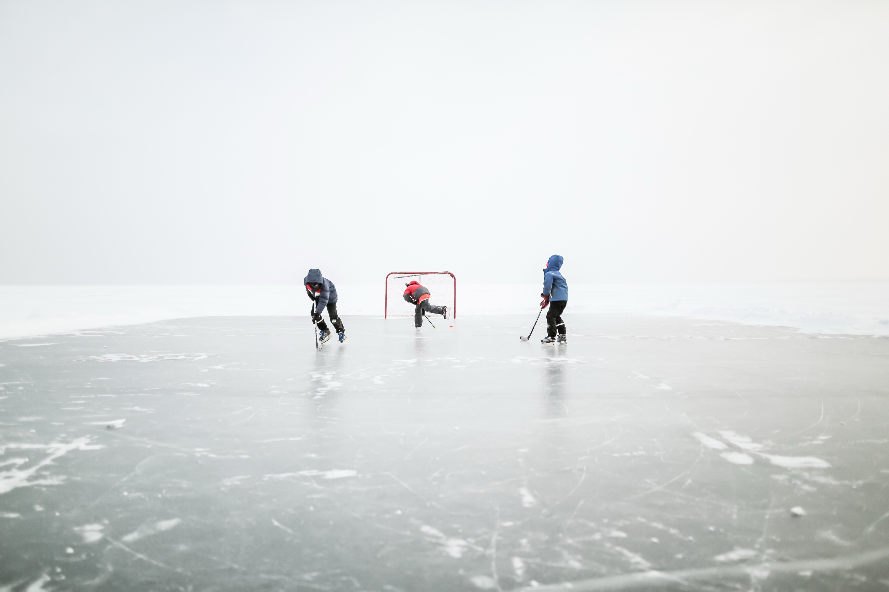
Active outdoor play connects communities
Notes:
Shared active outdoor play experiences build stronger communities, celebrate cultural traditions, and strengthen diversity while fostering a sense of belonging.^{27,67-71}
In turn, cohesive communities create safe and supportive environments that encourage citizenship, agency, and active outdoor play for all.^{67,68,71-75}

Slide 28
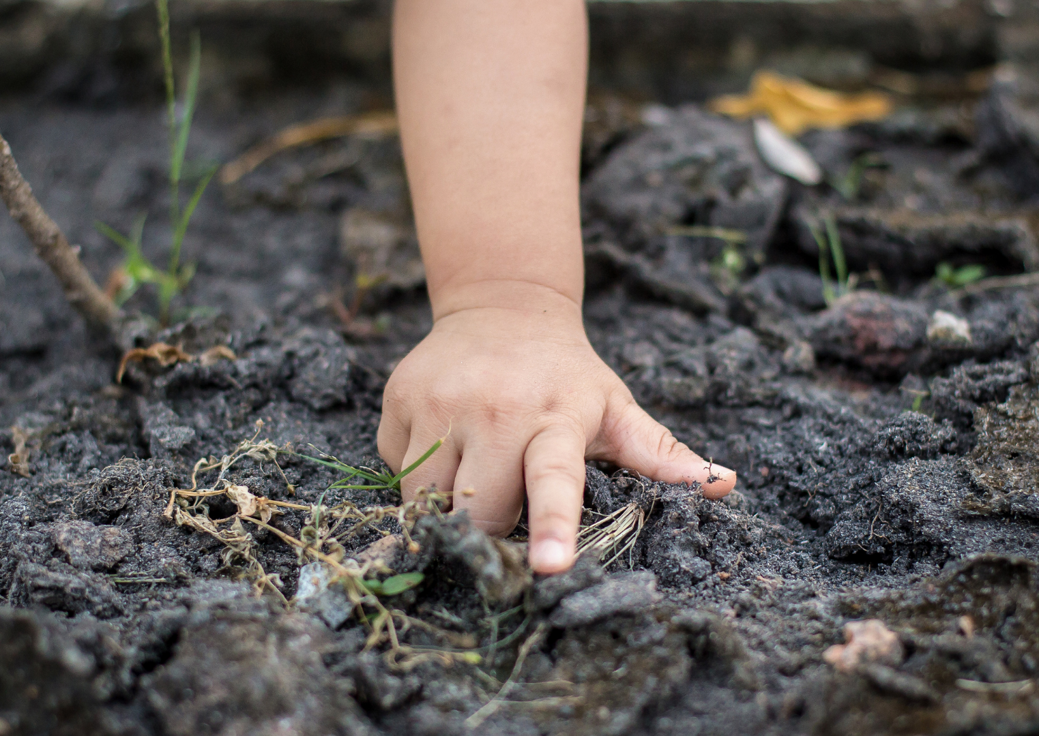
Active outdoor play facilitates diverse learning opportunities
Notes:
Active outdoor play can unlock a world of rich, hands-on learning experiences, sparking curiosity, creativity, collaboration, and problem-solving.^{27,41,76-79}
It nurtures resilience and adaptability, and supports social, emotional, and cognitive growth throughout life.^{46,50,76,80,81}

Slide 29
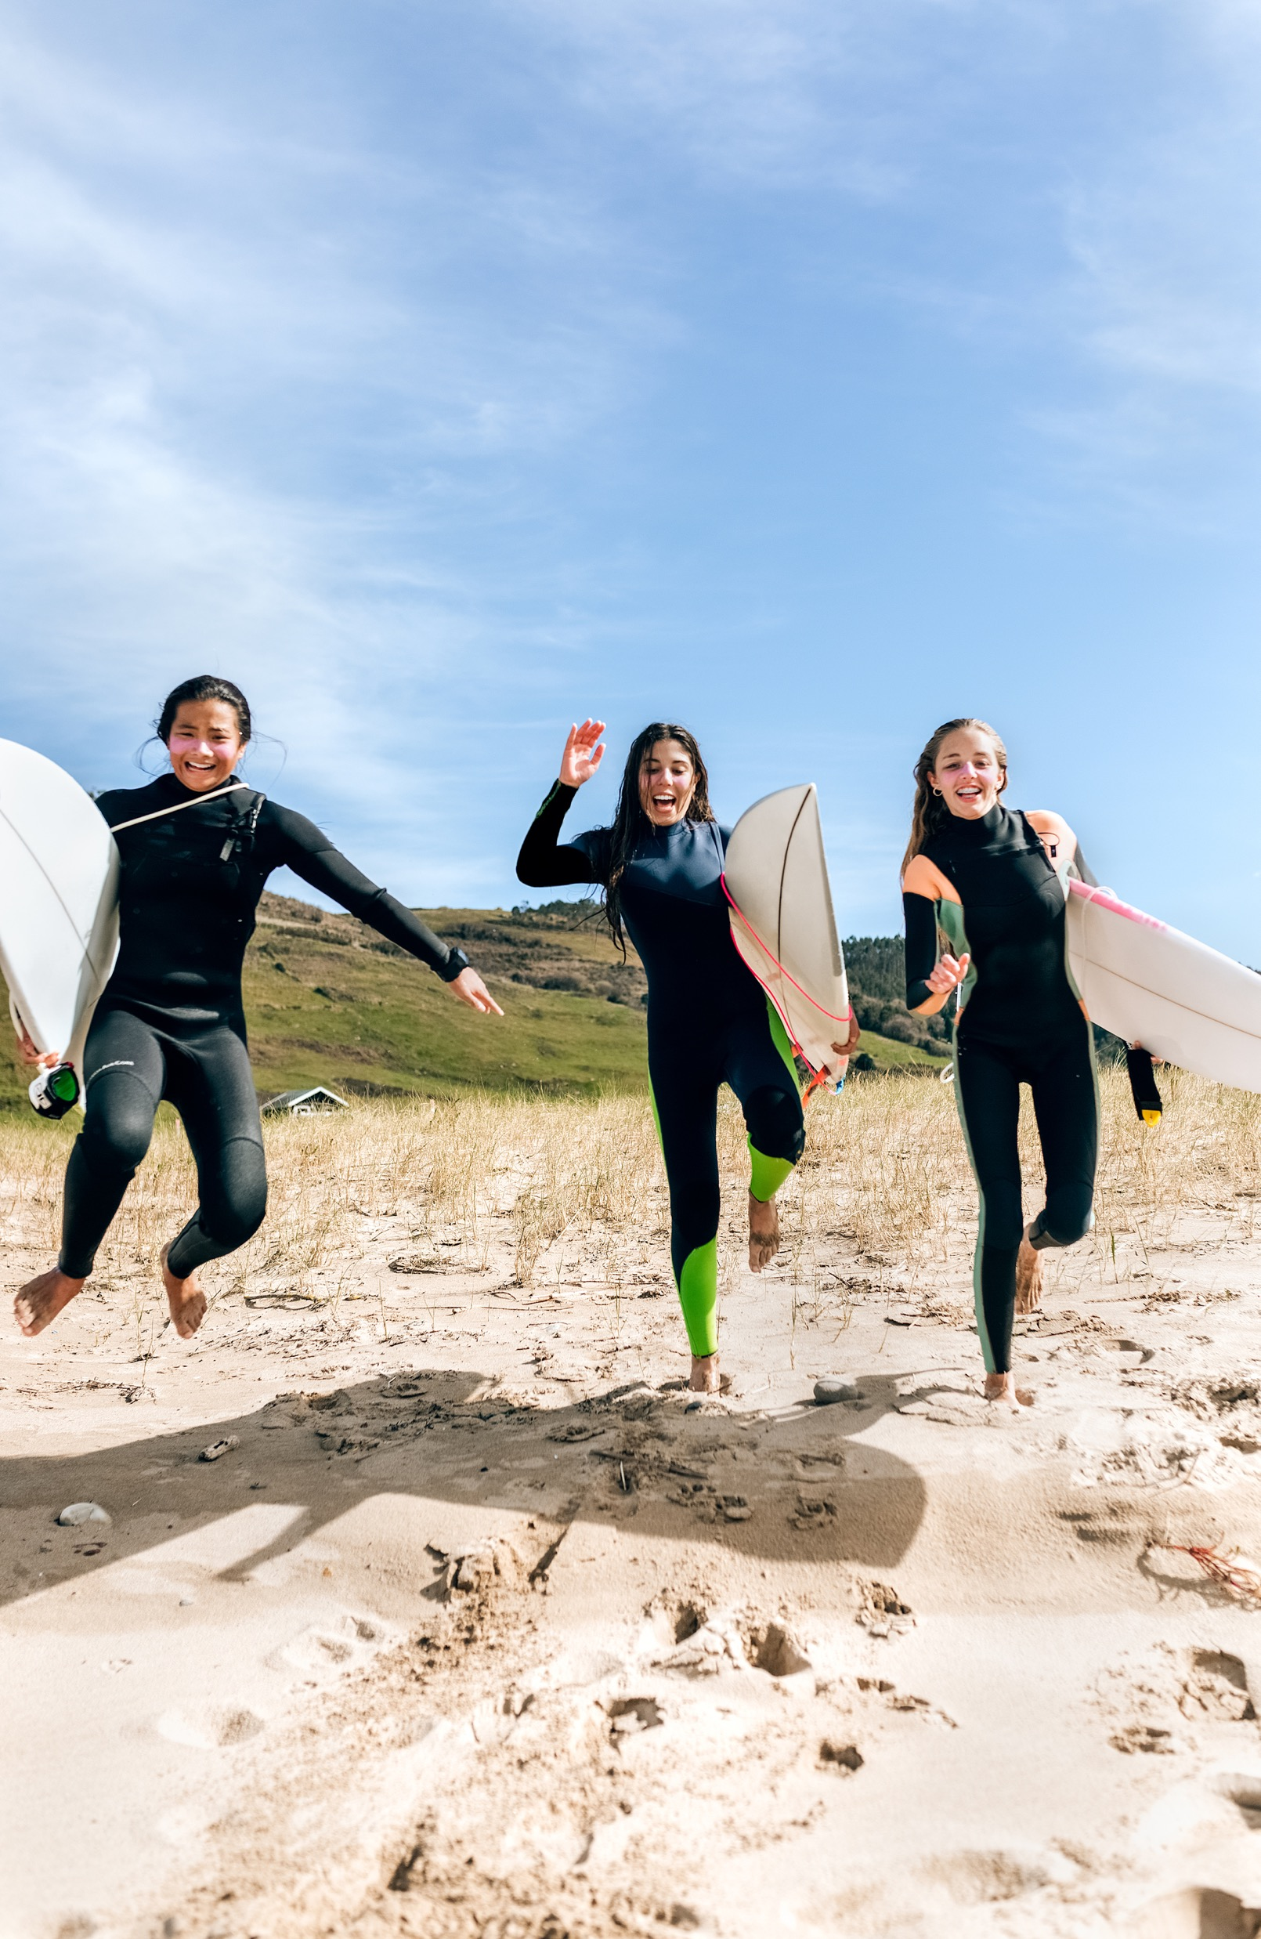
Active outdoor play can reduce excessive indoor time
Notes:
Excessive indoor time can contribute to prolonged sedentary behavior, increased screen time, and exposure to indoor pollutants, allergens, and infectious diseases.⁸²⁻⁸⁹
Active outdoor play provides a healthy balance in reducing time spent indoors.^{1,29,90}
Together, these 8 evidence statements based on scientific literature show that active outdoor play is not only vital for individuals—it is essential for thriving communities and a sustainable world.

Slide 30
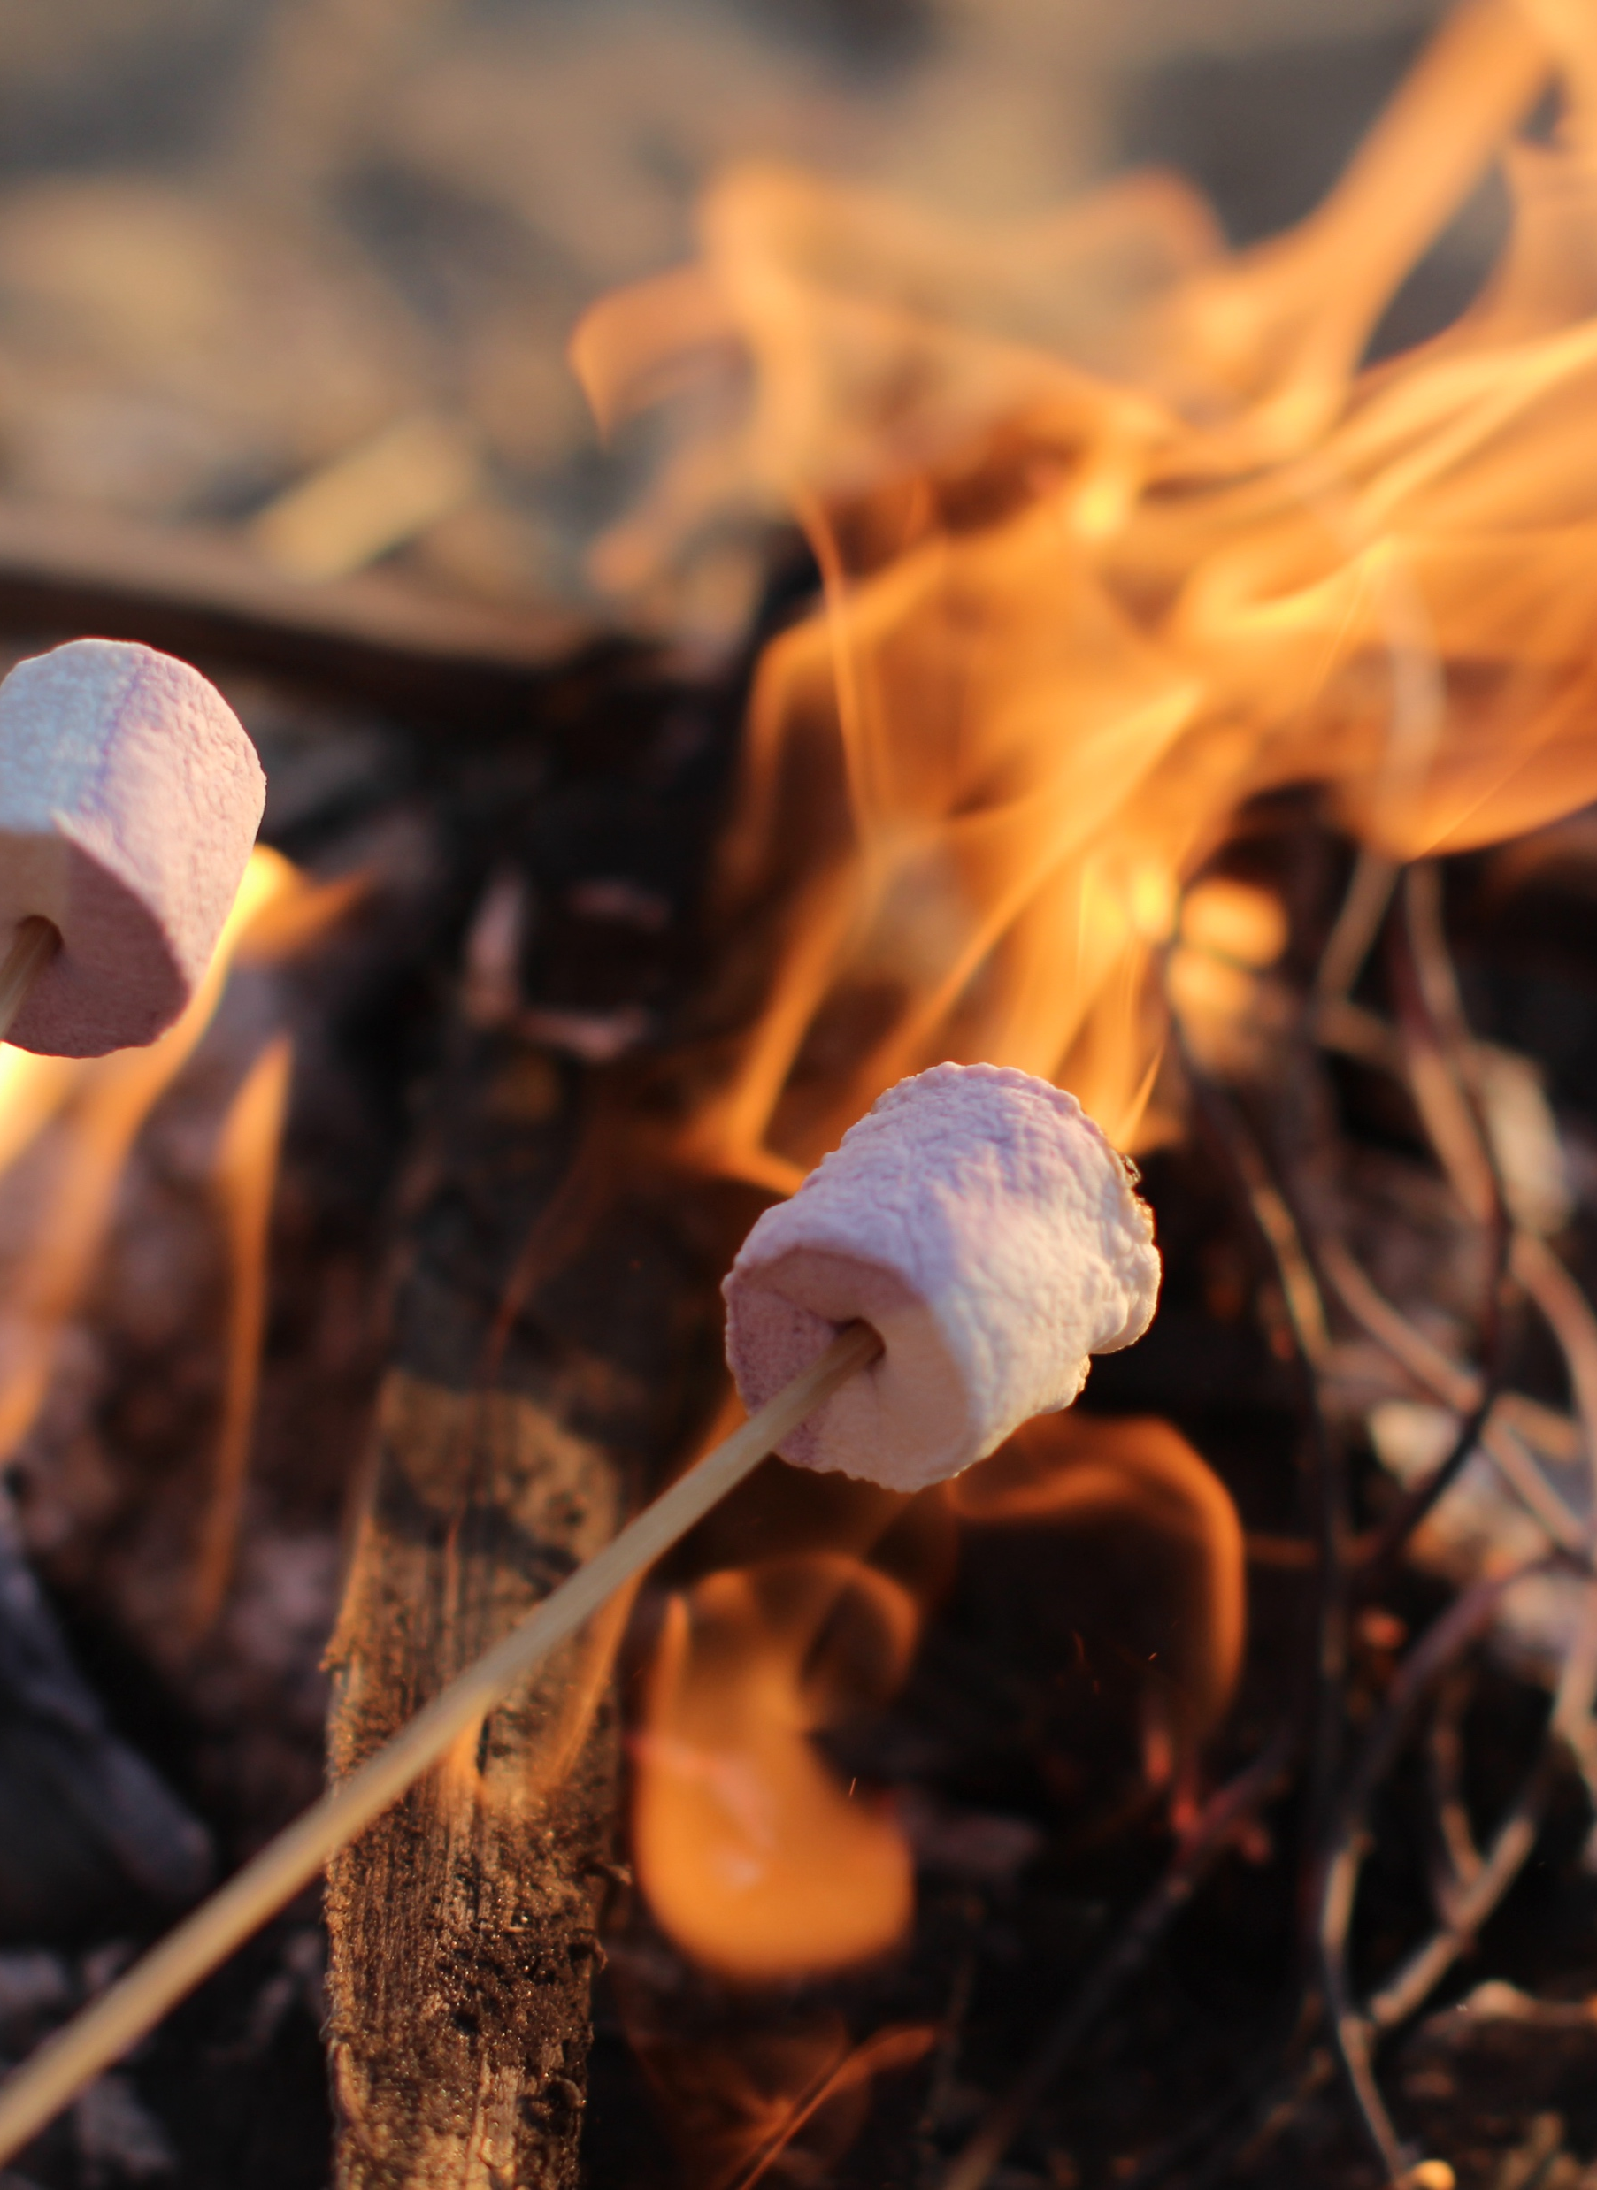
Emerging Areas:
Expanding the possibilities of active outdoor play
Can active outdoor play reshape adult movement patterns?
Could risky outdoor play be a key ingredient for brain plasticity?
What does active outdoor play look like around the world?
How do we bridge the gap between research and real-world play?
Can schools and schoolyards be redesigned and reprogrammed as playgrounds for movement, creativity, and learning?
How do we design cities that invite play at every turn?
Could active outdoor play be a conduit for global sustainability?
With rising concerns about screen time, anxiety, and loneliness, could active outdoor play be a powerful antidote to the adverse effects of social media use?
Notes:
What’s next for active outdoor play?
Can it reshape how adults move?
Could risky play spark brain plasticity?
What does it look like around the world?
How do we turn research into real-world action?
Imagine schools and schoolyards transformed into playgrounds for movement, creativity, and learning.
Imagine cities designed to invite play at every corner.
Could play even be a pathway to global sustainability?
And here’s the big one: with screen time, anxiety, and loneliness on the rise—could active outdoor play be the powerful antidote we’ve been searching for?
The possibilities are endless. The future of play is wide open.
The next step? Bold research, innovative policy, and a commitment to action!

Slide 31

A Call to Action:
Recommendations to promote active outdoor play
Societies
Research and Surveillance
Policy and Legislations
Education and Schools
Public Health and Healthcare
Urban Planning
Communities
Families
Individuals
Notes:
Now, we call on everyone to take action for active outdoor play!
We all have more than one role to play to promote active outdoor play!

Slide 32
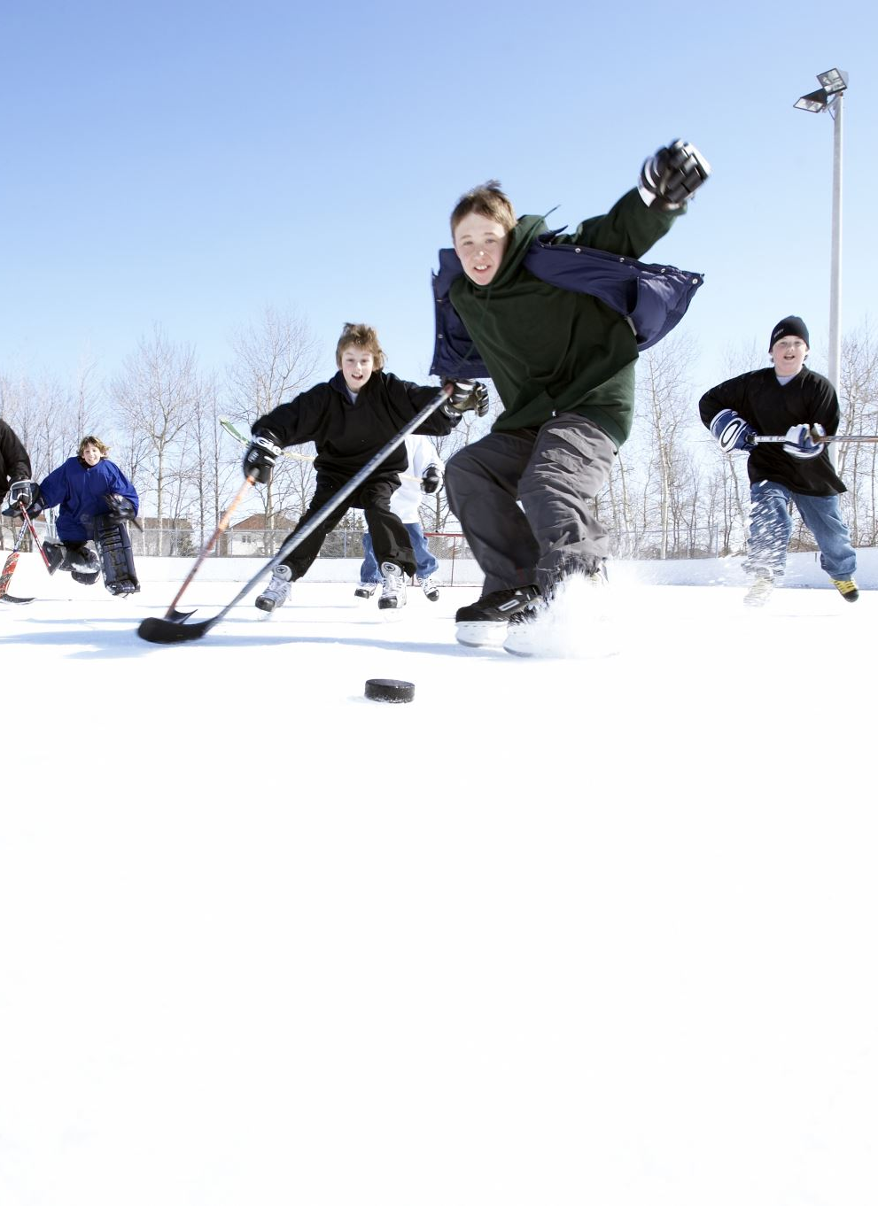
Societies:
Value Play! Protect Play!
Encourage a culture that values and prioritizes active outdoor play as part of daily life.
Create and improve access to spaces where everyone can enjoy active outdoor play.
Advocate for collaboration among researchers, educators, urban planners, health professionals, and policymakers to make active outdoor play a health priority.
Notes:
As a society,
Animation click

Slide 33
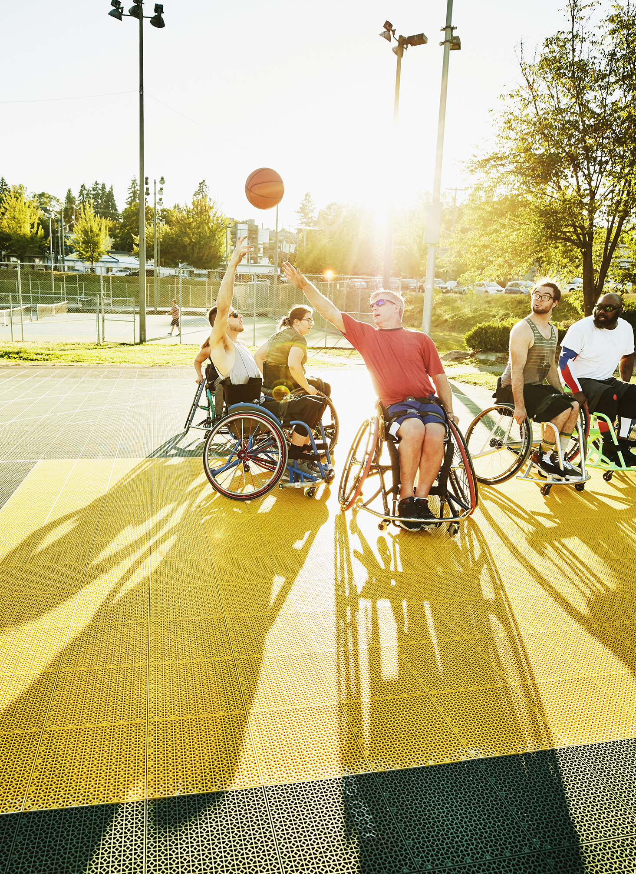
Research and Surveillance: Study It, Track It, Understand It!
Invest in data collection and monitoring systems to track trends in active outdoor play and to identify gaps and inequities.
Explore the optimal quality and quantity of active outdoor play for healthy people and communities.
Establish causal pathways between active outdoor play, and health and well-being outcomes.
Notes:
For Researchers, we need stronger data, better tools, and diverse perspectives to understand and promote outdoor play.

Slide 34
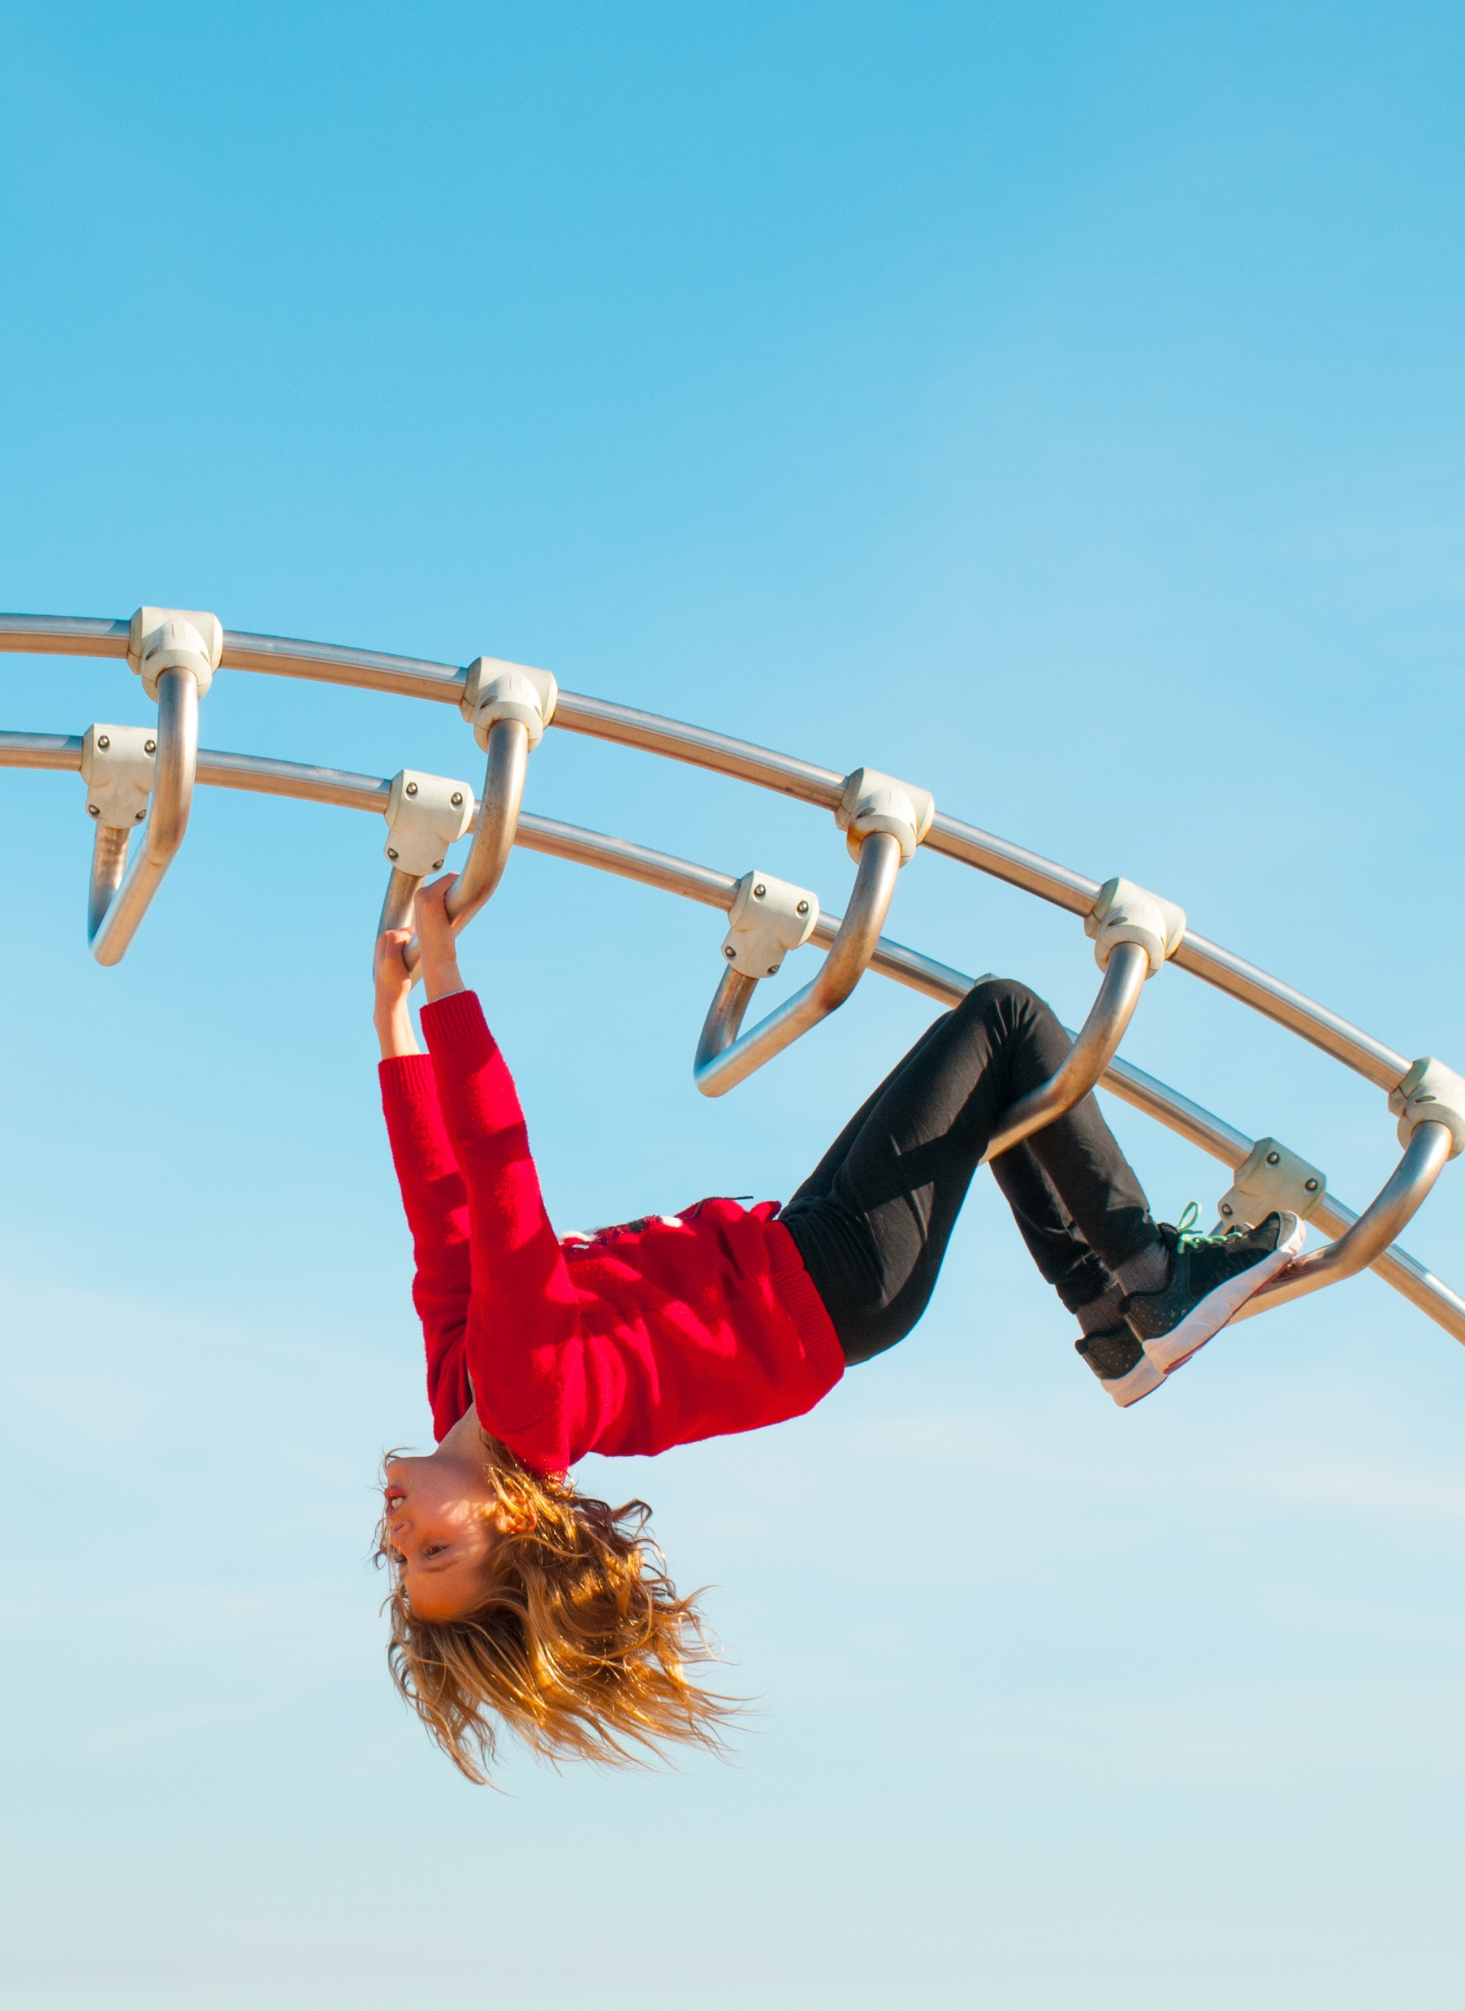
Policy and Legislation: Create Frameworks for Equitable Access!
Recognize access to active outdoor play as a fundamental right in health, education, recreation, and environmental policies.
Encourage governments to enact and uphold policies that support active outdoor play.
Promote, protect, value, and invest in outdoor play environments that connect neighborhoods, schools, recreational areas, and workplaces.
Notes:
For policy and legislation: create supportive frameworks that ensure equitable access to safe, playful environments.

Slide 35
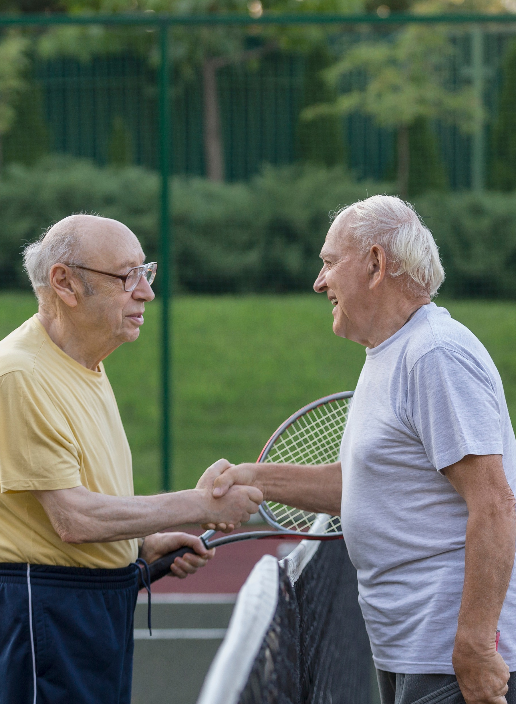
Education and Schools: Teach Through Play and Redesign Spaces!
Encourage colleges, adult education centers, and community learning centers to integrate ongoing professional development related to active outdoor play and learning into programs.
Require daily active outdoor playtime in early childhood education and K–12 school policies.
Integrate outdoor classrooms and nature-based learning into education systems.
Notes:
For education and schools: redesign curricula, classrooms, and schoolyards to integrate play as a cornerstone of learning.

Slide 36

Public Health and Healthcare: Prescribe Play for Health!
Educate medical professionals, patients, and communities on the health benefits of active outdoor play.
Integrate active outdoor play into healthcare practice and public health initiatives to reduce sedentary behavior and improve health.
Collaborate across sectors to develop localized public health strategies that promote active outdoor play.
Notes:
For public health and healthcare: prescribe and promote outdoor play as essential for holistic health and well-being.

Slide 37

Urban Planning: Design Cities that Invite Play!
Design accessible, safe, and play-friendly outdoor spaces in and around neighborhoods.
Prioritize the preservation and restoration of natural environments that encourage active outdoor play when designing or redesigning communities.
Reform municipal policies and bylaws to actively support and enable active outdoor play.
Notes:
For urban planning: design cities and neighborhoods that invite play at every turn.

Slide 38
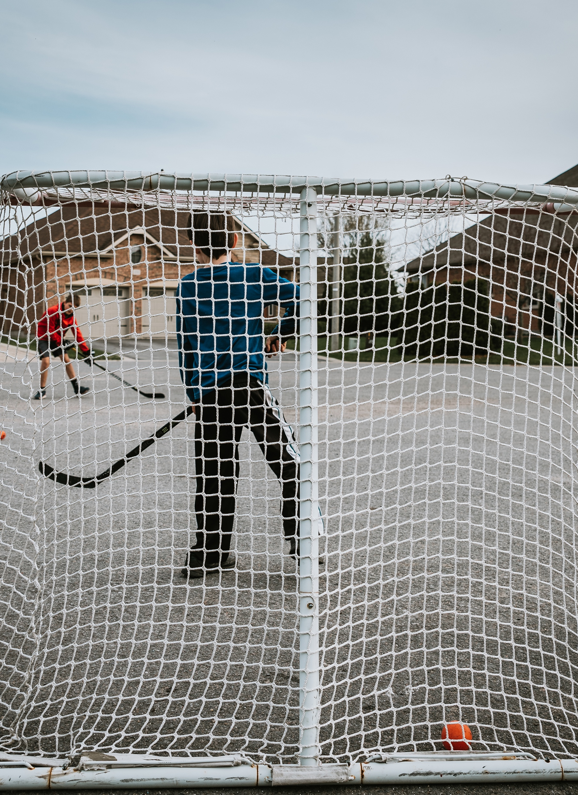
Communities: Create Safe, Inclusive Spaces!
Support, promote, and build on campaigns that emphasize the importance of active outdoor play as a health-promoting habit.
Support, promote, and build on efforts that promote benefit-risk approaches to active outdoor play.
Encourage intergenerational active outdoor play to strengthen community connections.
Notes:
For communities: foster safe, inclusive, and playful spaces where everyone belongs.

Slide 39
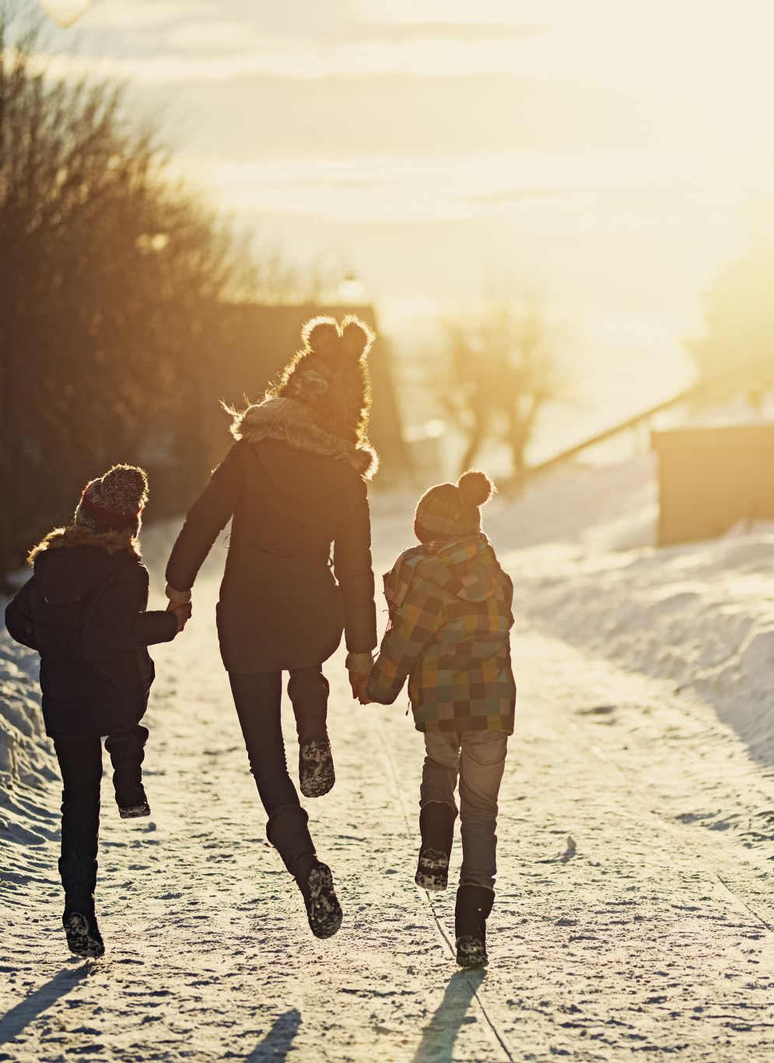
Families: Play Together, Outdoors!
Play with others, including companion animals, to nourish a sense of community and connection to the outdoors.
Encourage and model active outdoor play as a normative behavior in your neighborhood.
Support family members’ participation in active outdoor play by encouraging, facilitating, and engaging together.
Notes:
For families: make time for play, outdoors, together.

Slide 40
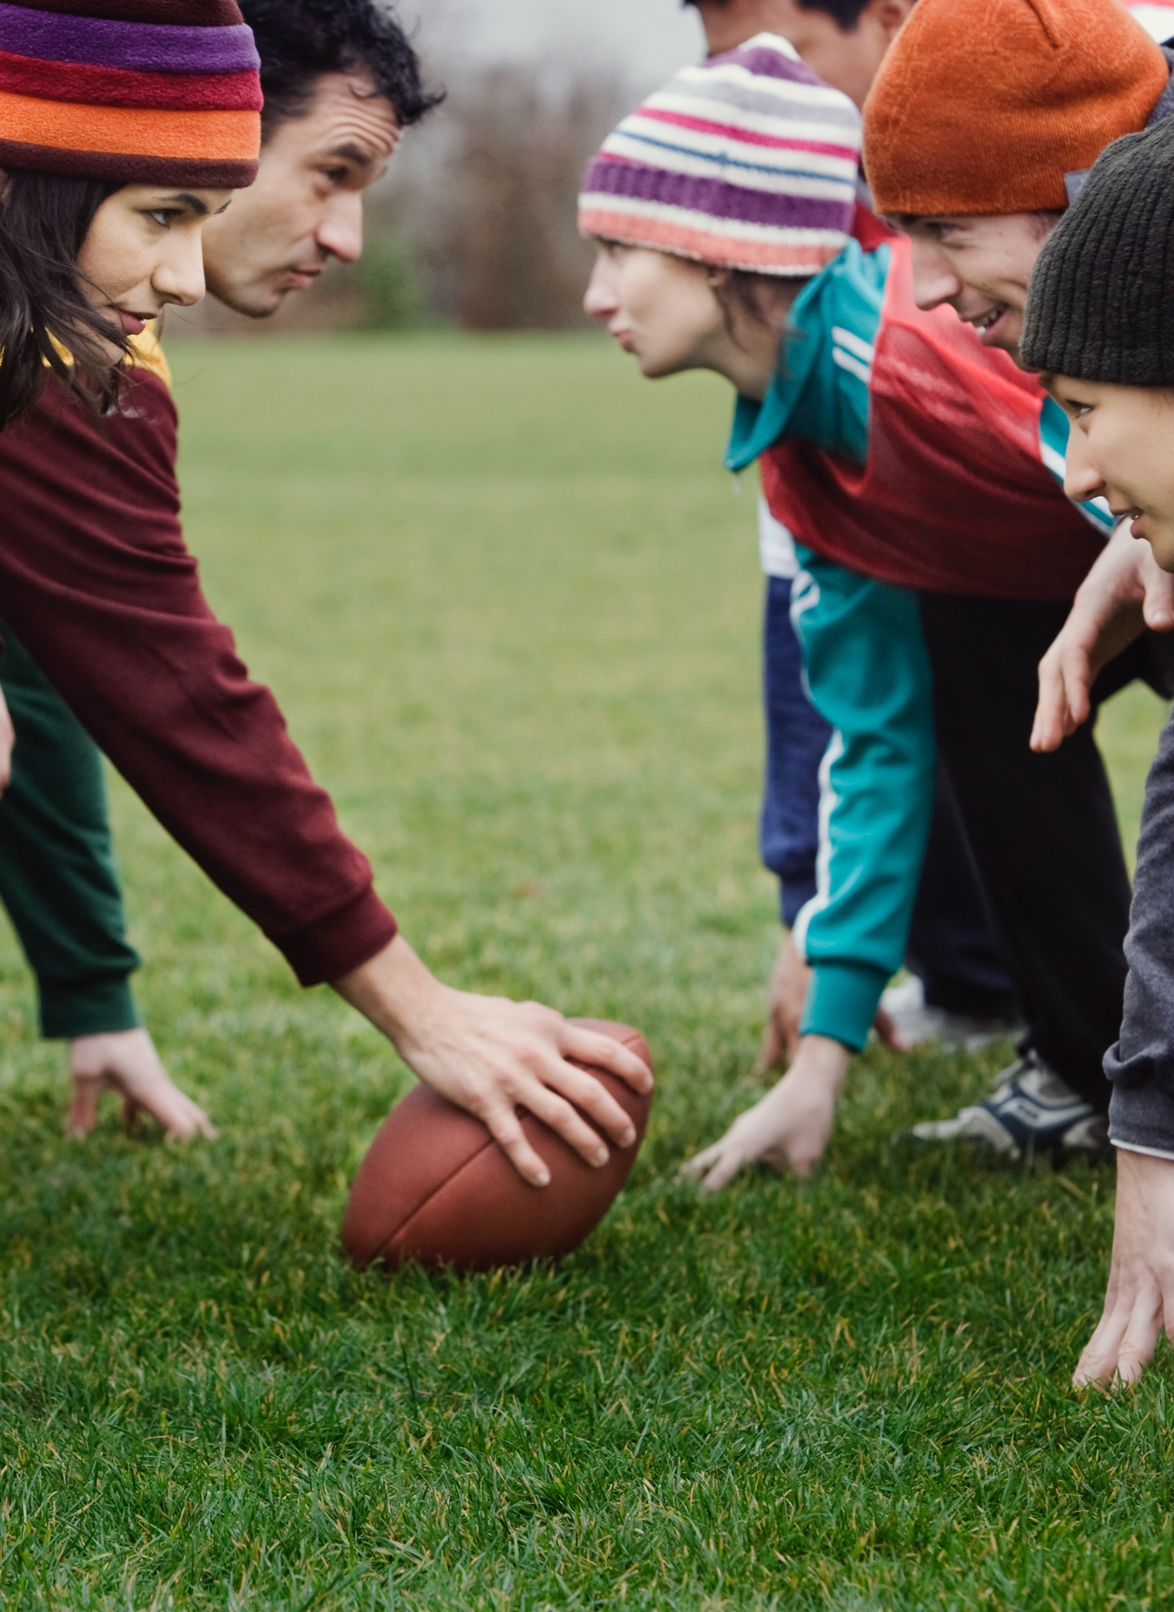
Individuals: Move, Explore, Embrace Play!
Be respectful stewards of the outdoor environments where play happens.
Advocate for equitable access and preservation of green spaces and safe play-friendly environments.
Explore and enjoy diverse experiences in different outdoor spaces as part of your daily routine
Notes:
Finally for every one of you: step outside, move, explore, and play.

Slide 41

Active outdoor play is essential for our health, our communities, and our planet. Together, we can make play a priority, today and for generations to come!
Notes:
hand over back to Louise

Slide 42


Endorse the 2025 Position Statement
There are 321 supporters of the 2025 Position Statement on Active Outdoor Play. To endorse the statement, visit Outdoor Play Canada's website by clicking the link or scanning the QR code.
www.outdoorplaycanada.ca/aop10/
Notes:
Let’s work together to make active outdoor play a part of everyday life, for every age, every community, and for our planet!

Slide 43
AOP10 Publications
2025 Position Statement on Active Outdoor Play: https://doi.org/10.1186/s12966-025-01813-9.
2025 Position Statement - Process and Methodology: https://doi.org/10.0.4.162/s12966-025-01806-8

Slide 44
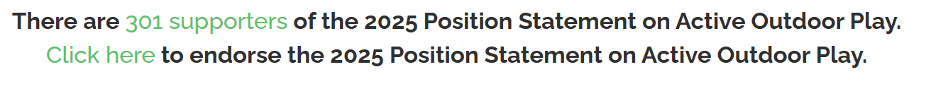
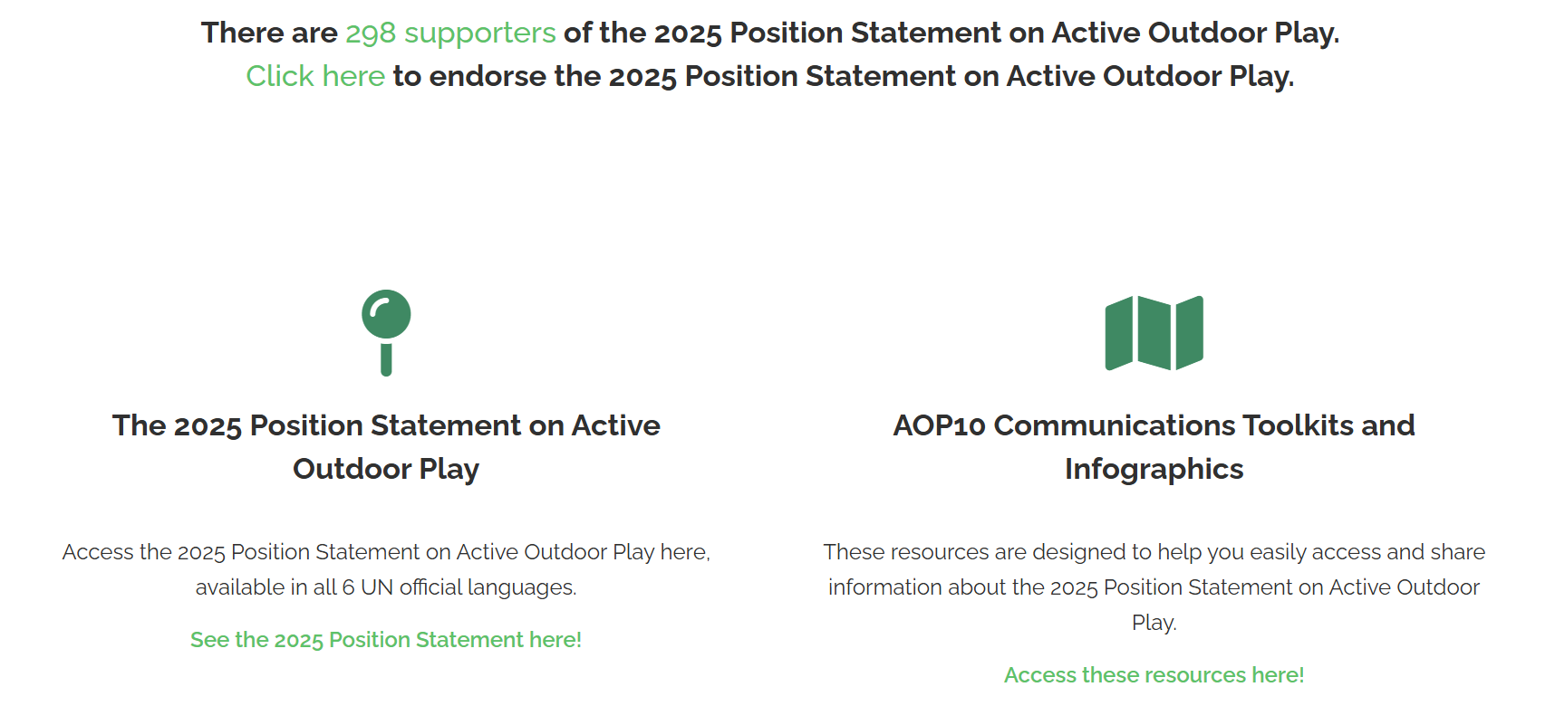
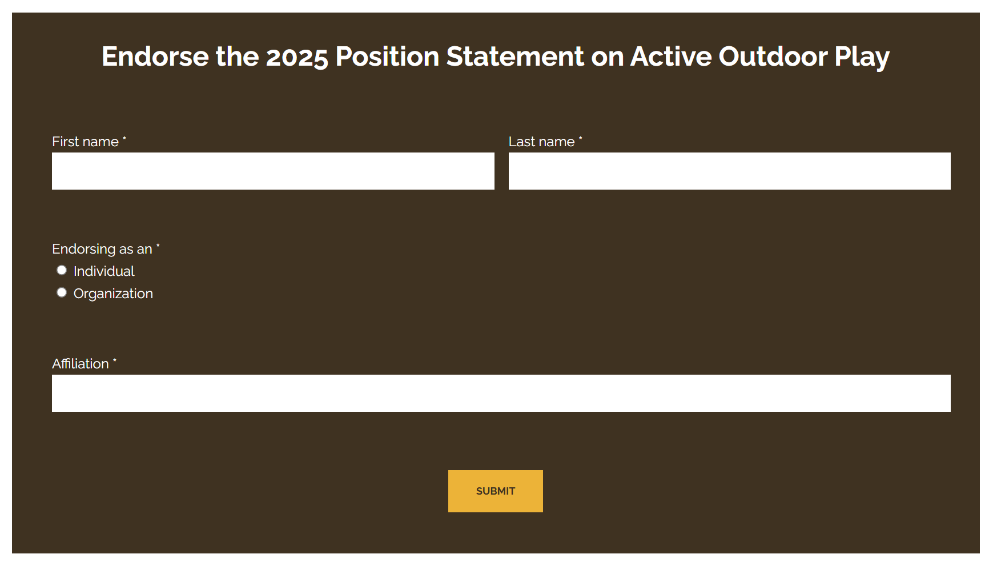
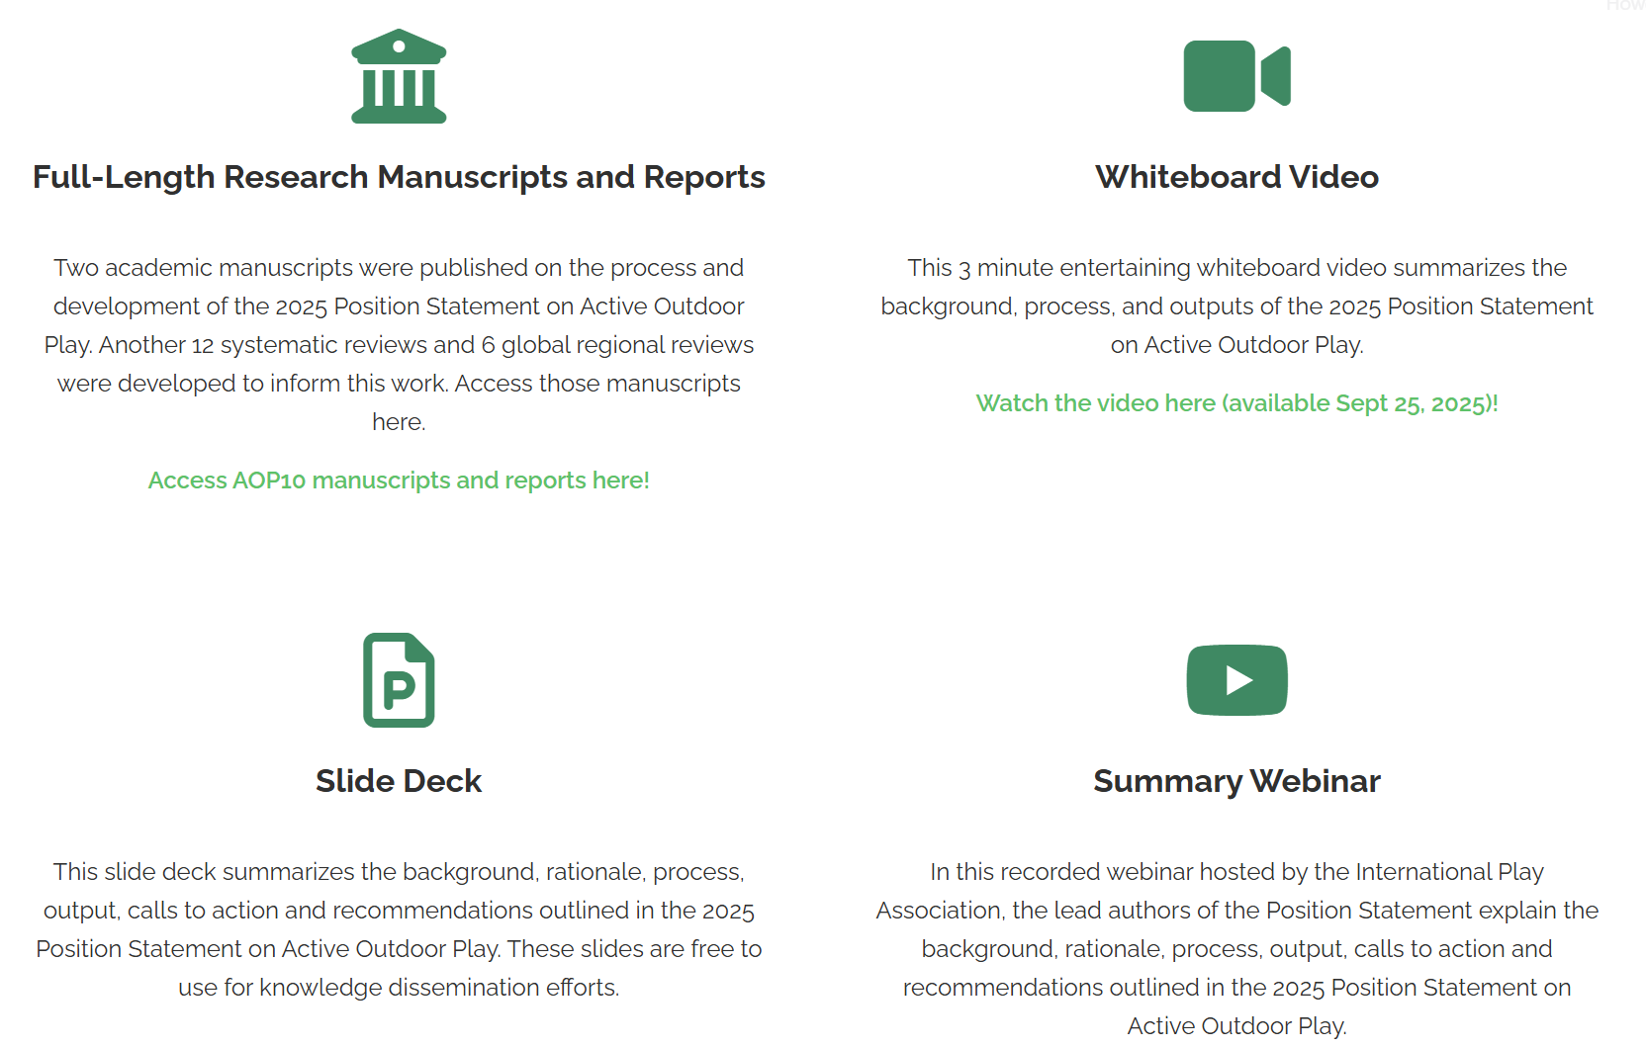
AOP10 Knowledge Translation and Mobilization
outdoorplaycanada.ca/aop10/

Slide 45

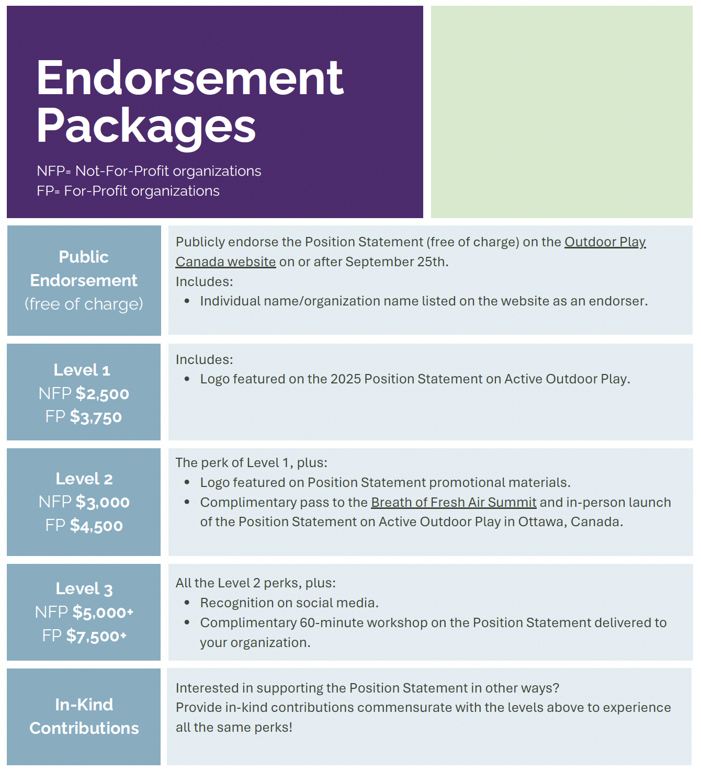


Global brand recognition
Position your organization as a leader in this collective movement to address global health challenges

Slide 46
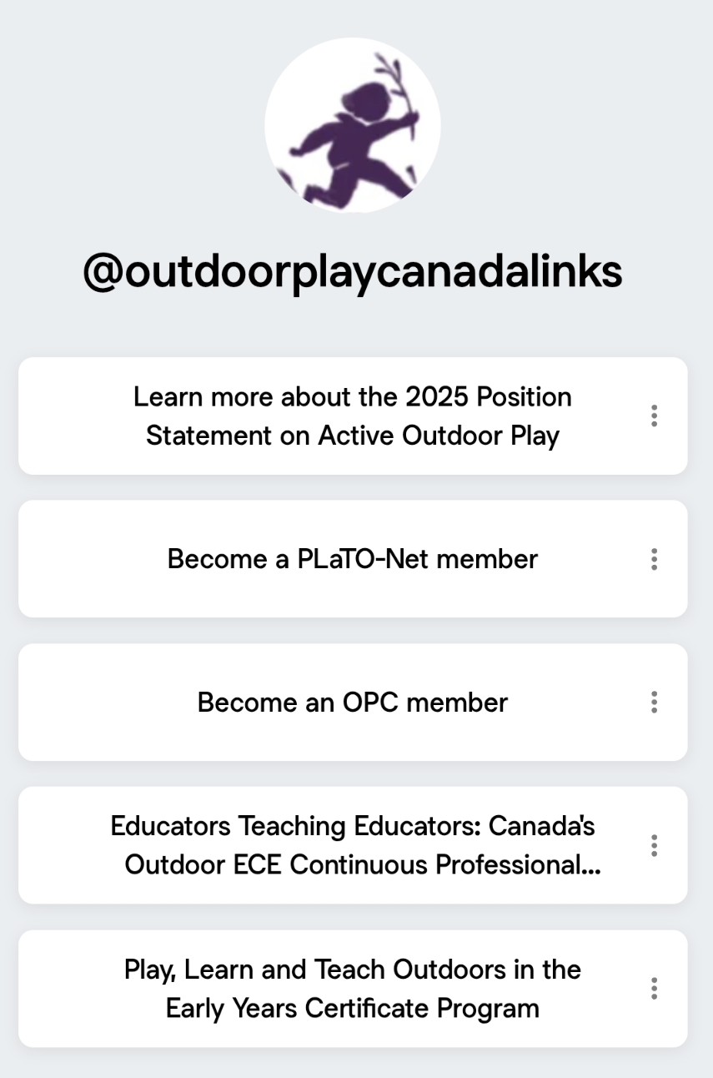






Join Us!
Scan the QR code to access our Linktree and become a part of the Outdoor Play Canada community.
facebook.com/OutdoorPlayCanada/​
@Ou﻿tdoorplayca​
@outdoorplayca.bsky.social​
info@outdoorplaycanada.ca​
outdoorplaycanada.ca

Slide 47
Thank you to our partners & supporters!
Questions?
AOP10 Partners
AOP10 Supporters

